Slide 1
PH-PNX-00023

Slide 2
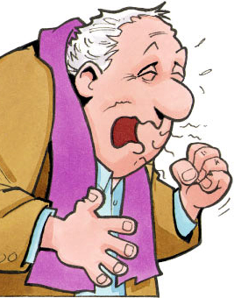
PULMONYA: SANHI, SINTOMAS at mga PARAAN PARA LABANAN ITO
[Pangalan ng Lecturer]

Slide 3
OUTLINE
1. Ilan ang namamatay at nagkakasakit sa bansa dahil sa pulmonya?
2. Ano ang pulmonya at mga sintomas nito?
3. Sino ang maaaring maapektuhan ng pulmonya?
4. Paano ito maiiwasan?
5. Sino ang dapat magpabakuna laban sa pulmonya?

Slide 4
OUTLINE
1. Ilan ang namamatay at nagkakasakit sa bansa dahil sa pulmonya?
2. Ano ang pulmonya at mga sintomas nito?
3. Sino ang maaaring maapektuhan ng pulmonya?
4. Paano ito maiiwasan?
5. Sino ang dapat magpabakuna laban sa pulmonya?

Slide 5
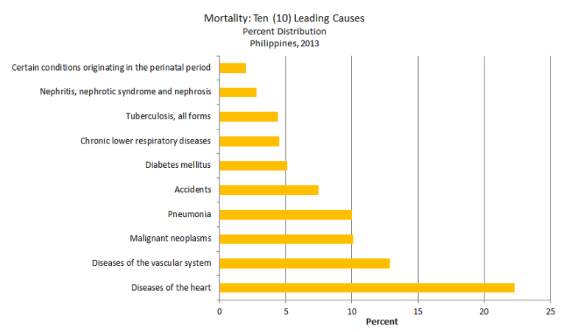
Ilan ang namamatay at nagkakasakit sa bansa dahil sa pulmonya?
Notes:
Out of 514,745 deaths registered in 2013, more than 81 percent (433,375) were attributed to the top ten leading causes of death for the year. Deaths from all other causes comprised less than 20 percent of total deaths or 97,905 cases. More than one in every five deaths was caused by Diseases of the Heart making it the number one leading cause of death. Diseases of the Heart remained to be the first with 118,740 deaths. It recorded a 22.3 percent share from total deaths.
Diseases of the Heart had been consistently the number one cause of death for several years now. The 2013 number of deaths from this condition is 6,159 deaths (5.4%) higher than what was reported in 2012 which had 112,581 deaths. This year’s number of deaths from Diseases of the heart comprised 22.3 percent of total deaths. More males than females die from this cause. Out of 118,740 cases reported, 66,612 or 56 percent were males and 52,128 or 44 percent were females. Thus, the death sex ratio for Diseases of the Heart was 1.28 or 129 males in every 100 females.
The next three diseases in the list which remained in their respective rankings for the past four years already were, Diseases of the Vascular System (68,325; 12.9%), Malignant Neoplasm (53,601; 10.1%) and Pneumonia (53,101; 10.0%).
http://www.doh.gov.ph/mortality

Slide 6
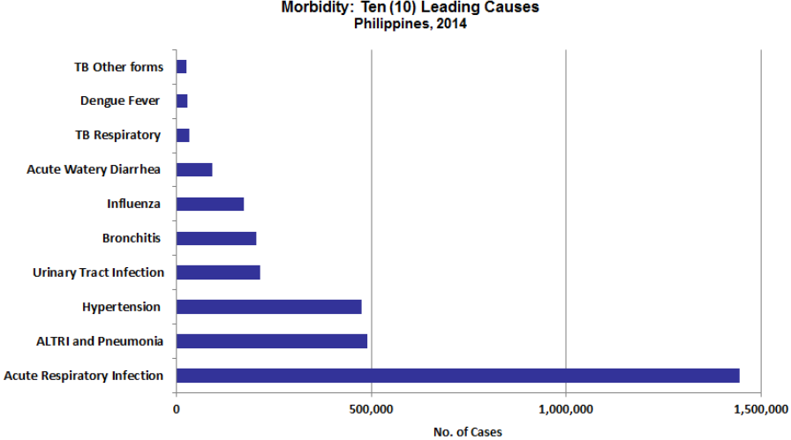
Ilan ang namamatay at nagkakasakit sa bansa dahil sa pulmonya?

Slide 7
PhilHealth Top 10 Admissions, 2016 (January- December)
 | Conditions | # of Cases | Total Amount (PhP)
1 | PNEUMONIA | 583,927 | 9,299,192,288.00
 | Moderate risk | 540,177 | 7,869,655,568.00
 | High risk | 43,750 | 1,429,536,720.00
2 | Hemodialysis procedure | 1,221,976 | 6,474,149,693.00
3 | Vaginal delivery | 722,902 | 4,998,763,070.00
4 | Cesarian delivery | 204,409 | 4,035,170,860.00
5 | Dengue fever | 205,729 | 2,001,477,340.00
6 | CVD stroke | 71,008 | 1,994,003,560.00
7 | Acute Gastroenteritis | 336,822 | 1,924,370,000.00
8 | Sepsis | 56,618 | 1,856,754,370.00
9 | Hypertensive emergency | 208,655 | 1,820,146,588.00
10 | Urinary tract infection, complicated | 202, 702 | 1,423,667,010.00

Slide 8
OUTLINE
1. Ilan ang namamatay at nagkakasakit sa bansa dahil sa pulmonya?
2. Ano ang pulmonya at mga sintomas nito?
3. Sino ang maaaring maapektuhan ng pulmonya?
4. Paano ito maiiwasan?
5. Sino ang dapat magpabakuna laban sa pulmonya?

Slide 9
Ano ang pulmonya at mga sintomas nito?
Impeksyon na umaapekto sa baga
Hindi malubhang sipon o trangkaso ang pulmonya
Viruses
Bacteria
Fungi
SAKIT?
SANHI?
Ubo
Lagnat
Hirap sa paghinga
SINTOMAS?
Notes:
https://www.cdc.gov/pneumonia/index.html

Slide 10
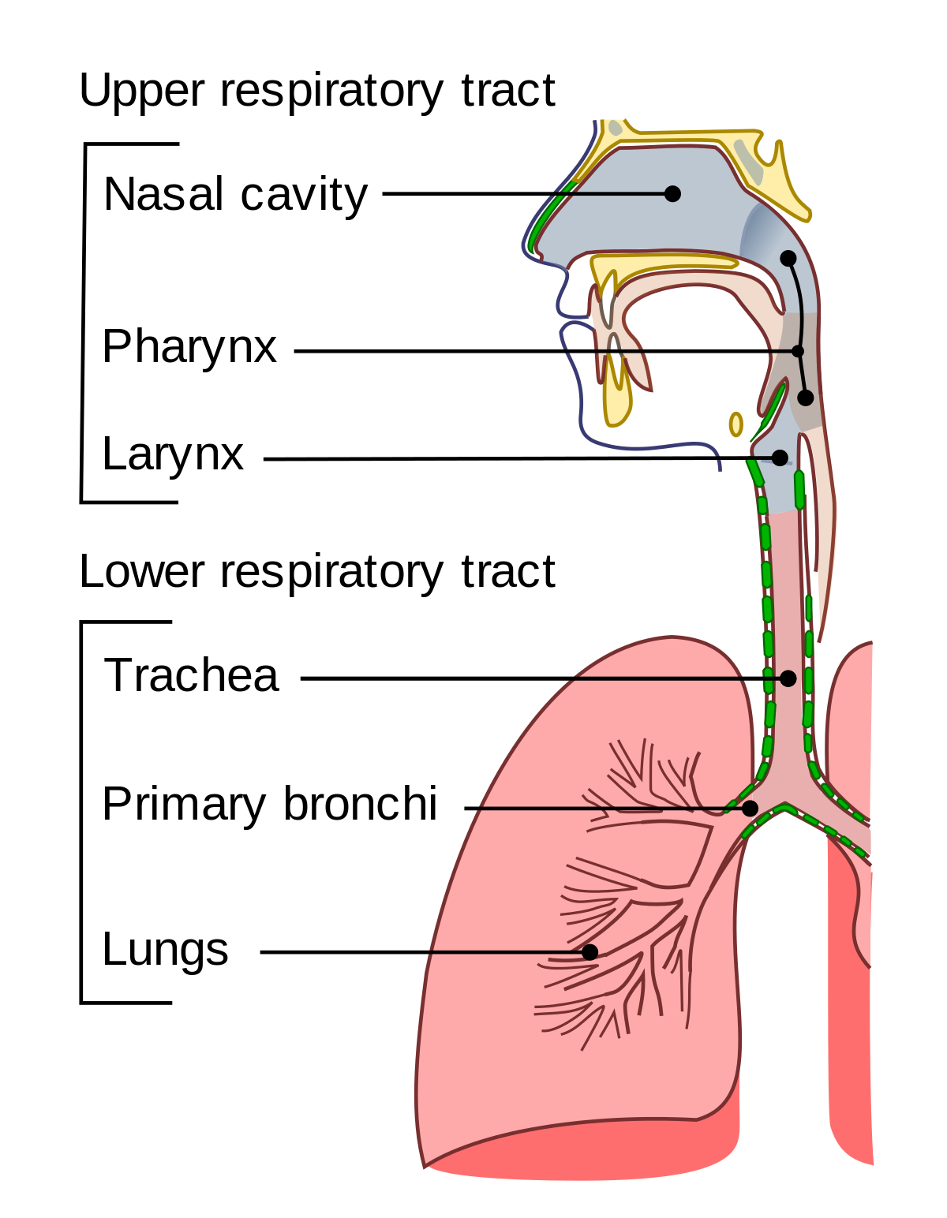
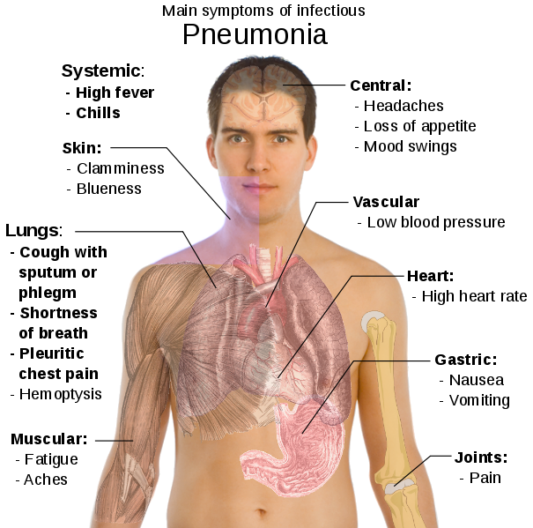
Notes:
http://diseasespictures.com/wp-content/uploads/2014/03/Pneumonia.png
https://upload.wikimedia.org/wikipedia/commons/thumb/9/9f/Illu_conducting_passages.svg/1200px-Illu_conducting_passages.svg.png

Slide 11
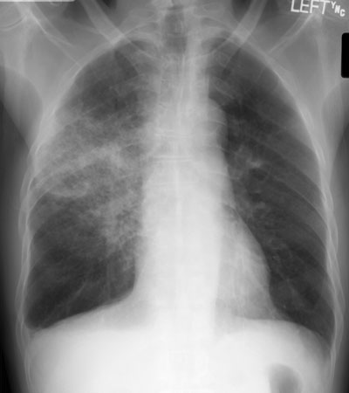
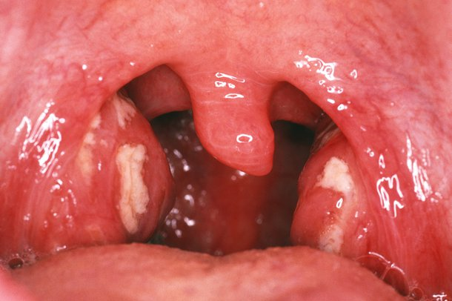
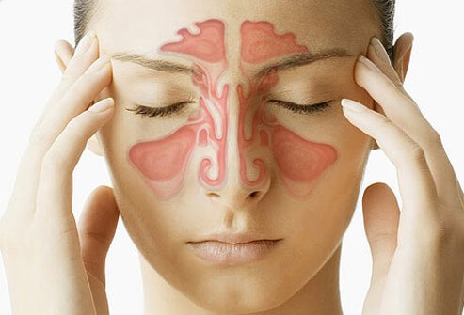
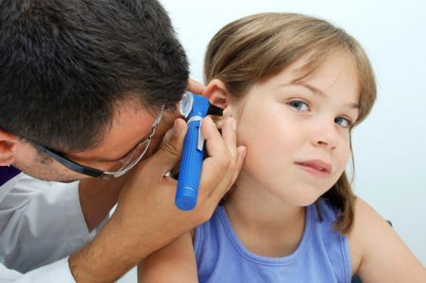
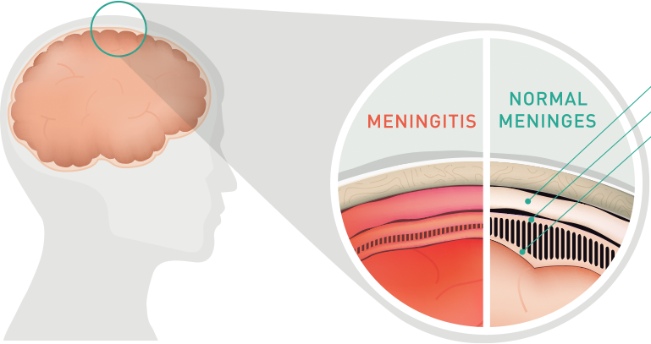
SANHI ng PULMONYA: Streptococcus pneumoniae
PNEUMONIA
TONSILLITIS
SINUSITIS
OTITIS MEDIA
MENINGITIS
Notes:
https://www.med-ed.virginia.edu/courses/rad/cxr/web%20images/rul-pneumonia-pa.jpg
https://assets.nhs.uk/prod/images/M2700195-Tonsillitis-SPL.width-610.jpg
https://images.medicinenet.com//images/slideshow/sinusitis_s1_woman_sinus_cavity.jpg
http://mybabyclinic.com//uploads/news_images/451x300_a7d87f616c7eb6317dd9674cc62a751488271214.jpg
http://www.voicesofmeningitis.org/assets/media/images/meningitis-illustration.png

Slide 12
OUTLINE
1. Ilan ang namamatay at nagkakasakit sa bansa dahil sa pulmonya?
2. Ano ang pulmonya at mga sintomas nito?
3. Sino ang maaaring maapektuhan ng pulmonya?
4. Paano ito maiiwasan?
5. Sino ang dapat magpabakuna laban sa pulmonya?

Slide 13
Sino ang maaaring maapektuhan ng pulmonya?
Naninigarilyo (Nahihirapan lumaban ang baga sa mga impeksyon dahil sa paninigarilyo)
Mga mahilig gumamit ng antibiotics na hindi riniseta ng doktor

Slide 14
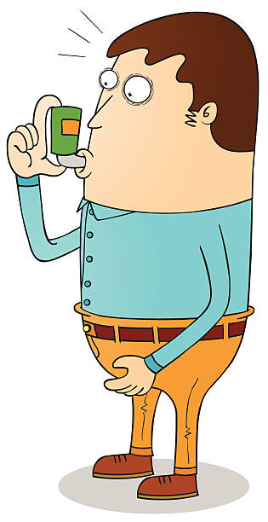
Sino ang maaaring maapektuhan ng pulmonya?
Mababa ang nutrisyon sa katawan
Mga may ibang sakit tulad ng asthma, diabetes, sakit sa puso o sakit sa bato
Mga may kanser o HIV

Slide 15
OUTLINE
1. Ilan ang namamatay at nagkakasakit sa bansa dahil sa pulmonya?
2. Ano ang pulmonya at mga sintomas nito?
3. Sino ang maaaring maapektuhan ng pulmonya?
4. Paano ito maiiwasan?
5. Sino ang dapat magpabakuna laban sa pulmonya?

Slide 16
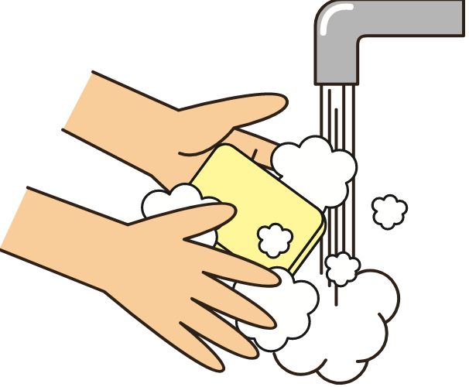
Paano ito maiiwasan?
Good hygiene practices
MAGHUGAS NG KAMAY
LINISIN NANG MAAYOS ANG MGA MADALAS GAMITIN
KAPAG UUBO o BABAHING – SIGURADUHING SA MANGAS NG DAMIT AT HINDI SA KAMAY (PARA HINDI MAKAHAWA NG IBA)

Slide 17
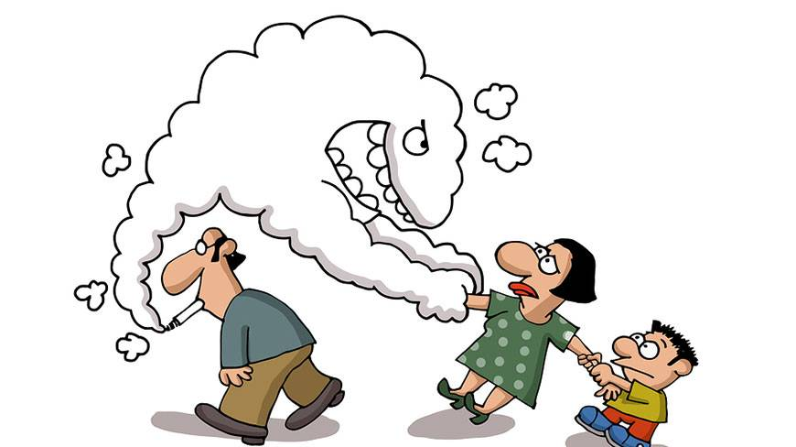
Paano ito maiiwasan?
Huminto sa paninigarilyo
Iwasan ang secondhand smoking o usok ng sigarilyo

Slide 18
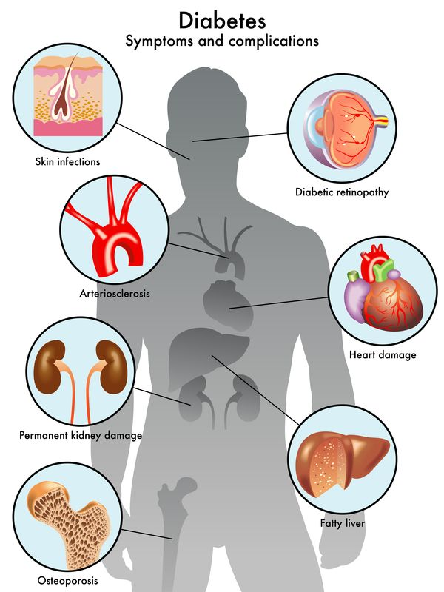
Paano ito maiiwasan?
Siguraduhing nagpapa-check up para sa ibang mga sakit at inaalagaan ang sarili upang hindi ito lumala (Halimbawa: Diabetes o sakit sa puso)

Slide 19
Paano ito maiiwasan?
Pagpapabakuna

Slide 20
OUTLINE
1. Ilan ang namamatay at nagkakasakit sa bansa dahil sa pulmonya?
2. Ano ang pulmonya at mga sintomas nito?
3. Sino ang maaaring maapektuhan ng pulmonya?
4. Paano ito maiiwasan?
5. Sino ang dapat magpabakuna laban sa pulmonya?

Slide 21
PAGPAPABAKUNA LABAN SA PULMONYA
Ang pulmonya ay karaniwan sa mga bata ngunit ang mga nakatatanda at mga may iba pang mga sakit tulad ng diabetes o sakit sa puso - ay mas higit pang nanganganib na madapuan ng nakamamatay na sakit na ito.

Slide 22
Sino ang HINDI pwedeng tumanggap ng bakuna (pneumococcal polysaccharide vaccine)?
Ang mga may allergy o hypersensitivity sa anumang bahagi ng bakuna
Mga batang wala pang 2 taong gulang
*Kung hindi sigurado, maiging itanong sa doktor.

Slide 23
REKOMENDASYON PARA SA PAGPAPABAKUNA LABAN SA PULMONYA

Slide 24
☑ Chronic lung disease (including Bronchial asthma, Tuberculosis)
☑ Chronic cardiovascular/renal/liver diseases
☑ Diabetes mellitus
☑ Cochlear implants
☑ CSF fluid leaks
☑ Immunocompromised conditions:
Functional and anatomic asplenia
Leukemia and lymphomas
Generalized malignancy
Transplants
Chemo/radiation therapy
HIV/AIDS
Alcoholism
Residents of nursing homes or long-term care facilities
Smokers
WHO SHOULD GET VACCINATED?
☑
☑ Without history of pneumococcal vaccination
2 to 50 YEARS OLD
50 YEARS OLD & ABOVE
SINO ANG KAILANGANG BAKUNAHAN?

Slide 25
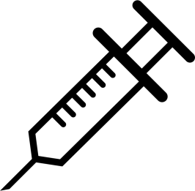
At least 1 YEAR
☑ PPSV23
PCV 13
At least 1 YEAR
At least 1 YEAR
☑ PPSV23
PCV 13
PPSV23
< 50 years old
> 50 years old
5 YEARS
☑ PPSV23
PPSV23
*3rd Dose of Revaccination of PPSV23 - depend on immunocompromised status, age and co-morbidities (ex. DM)
REVACCINATION
At least 1 YEAR
PCV 13
PPSV23
NONE

Slide 26
2017 Adult Immunization Guideline
(as of June 2017)
PNEUMOCOCCAL Vaccination | Target Individuals | Schedule
Conjugate (PCV13) Intramuscular Polysaccharide (PPSV23) Intramuscular or Subcutaneous | Recommended for all susceptible adults particularly: Age 50 years and older without history of pneumococcal vaccination Adults <50 years old with: Chronic lung disease (including bronchial asthma, tuberculosis) Chronic cardiovascular/renal/liver diseases Diabetes mellitus Alcoholism Cochlear implants CSF fluid leaks Immunocompromised conditions: Functional and anatomic asplenia Leukemia and lymphomas Generalized malignancy Transplants Chemo/radiation therapy HIV/AIDS Residents of nursing homes or long-term care facilities Smokers | Recommended vaccine PCV13 to be given first FOR Elderly Immunocompetent If PCV13 given first give PPSV23 after 6-12 months For Elderly Immunocompromised PCV 13 then PPSV 23 at least 8 weeks For Booster dose Single dose of PPSV 23 after 5 years Precautions / Contraindications An Immediate Anaphylactic Reaction to a previous dose of pneumococcal Vaccine Allergy to a vaccine component anaphylaxis to phenol or thiomersal Moderate to severe illness with or without fever
No previous vaccination:
PCV 13 first, followed by PPSV23 at least 1 year after the PCV13 dose
Previously received PPSV23:
should receive PCV13 to be given at least 1 year after the dose of PPSV23
Previously received PPSV23 at less than 50 years old, but who are now 50 years old or more:
1 dose of PCV13 at least 1 year after the most recent dose of PPSV23, then 1 dose of PPSV23 after 1 year of the PCV13 dose
Revaccination
1 dose PPV23 maybe given 5 years after last dose of PPV23
Reference: Schedule for Adult Immunization 2017 , Philippine Society for Microbiology and Infectious Diseases (PSMID), and Philippine Foundation for Vaccination (PFV) Updated as of April 2017

Slide 27
OUTLINE
1. Ilan ang namamatay at nagkakasakit sa bansa dahil sa pulmonya?
2. Ano ang pulmonya at mga sintomas nito?
3. Sino ang maaaring maapektuhan ng pulmonya?
4. Paano ito maiiwasan?
5. Sino ang dapat magpabakuna laban sa pulmonya?

Slide 28
OUTLINE
☑ Ilan ang namamatay at nagkakasakit sa bansa dahil sa pulmonya?
☑ Ano ang pulmonya at mga sintomas nito?
☑ Sino ang maaaring maapektuhan ng pulmonya?
☑ Paano ito maiiwasan?
☑ Sino ang dapat magpabakuna laban sa pulmonya?

Slide 29
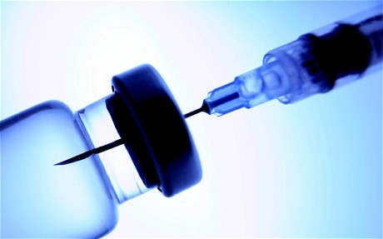
Ang Kahalagahan ng Pagpapabakuna

Slide 30
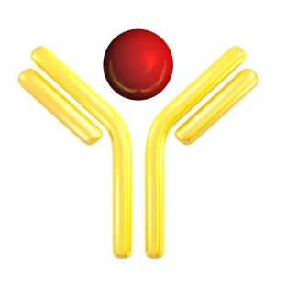
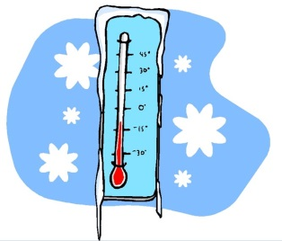
Vaccine Development ¹
Sinisiguro ng mga siyentipiko (scientists) at manufacturers na ang mga bakuna ay:
Epektibo laban sa mga impeksyon
Nagbibigay ng pangmatagalang proteksyon
Nagbibigay ng “immunity” gamit ang “minimal” na dosis
Nagbibigay ng pinakamalawak na proteksyon
Ligtas sa malulubhang side effects
Napapanatili ang pagkatatag kapag nakaimbak sa tamang temperatura
Magagamit na pang-masa
Abot-kaya sa mga nangangailangan nito
¹ World Health Organization. Vaccine Safety Basics. Learning Manual. 2013
Notes:
Vaccine manufacturers and scientists ensure that the vaccines are effective against infections, can provide a lasting and the broadest protection with the least number of doses, without or the mildest adverse events. They make sure that vaccines are stable at extremes of storage temperatures. The vaccines should also be available for general use and safe for mass production and affordable to the general population especially those who are at risk to acquire the diseases.

Slide 31
Alam niyo ba ……
Buhay ng tao ang naisasalba ng pagpapabakuna, maliban pa sa iwas-gastos?
May mga bakuna laban sa higit na 20 sakit na dulot ng ibat ibang bacteria o virus?
Na ang pagpapabakuna ay itinuturing na pangalawang natatanging imbento ng 20th century, pagkatapos ng pagkadiskubre sa malinis na tubig pang inom?

Slide 32
Alam niyo ba ….
Na ang mga bakuna ay dumaan sa mahabang proseso ng pananaliksik (research and development) bago ito ginagamit sa tao?
Na sa kasalukuyan, dalawang bakuna lamang ang napag-alamang nakakapagbigay ng laban mula sa cancer?
Ang HPV vaccine laban sa cancer ng ari ng lalaki at babae
Ang hepatitis B vaccine laban sa cancer ng atay

Slide 33
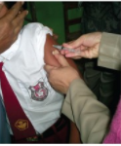
Kung ang natural na impeksyon ay nagdudulot ng pagka-immune, bakit pa kailangan ang pagbabakuna?
VACCINATION
NATURAL INFECTION
IMMUNITY
Maaaring hindi pangmatagalan ang proteksyon
Maaaring magkakumplikasyon dahil sa sakit
Hindi dumadaan sa pagkakaroon ng sakit
Maliit lang ang posibilidad ng side effects
Notes:
Immunity may be acquired two ways. One is by getting natural infection and the other is by vaccination. By acquiring the natural infection, we also become prone to complications that can range from hypersensitivity reaction to death. Many of the cases in the prevaccine era acquired immunity through natural infection but many were not able to survive the severe complications of those vaccine preventable diseases. Vaccination on the other hand eliminates the fact that a person endures the illness. There is also a low risk of adverse reactions that greatly outweighs the risk of complications by natural infections.

Slide 35
Selected Safety Information
Do not administer PNEUMOVAX 23 to individuals with a history of a hypersensitivity reaction to any component of the vaccine.
Defer vaccination with PNEUMOVAX 23 in persons with moderate or severe acute illness.
Use caution and appropriate care in administering PNEUMOVAX 23 to individuals with severely compromised cardiovascular and/or pulmonary function in whom a systemic reaction would pose a significant risk.
PNEUMOVAX 23 should be given to a pregnant woman only if clearly needed.
Caution should be exercised when PNEUMOVAX 23 is administered to a nursing woman.
Since elderly individuals may not tolerate medical interventions as well as younger individuals, a higher frequency and/or a greater severity of reactions in some older individuals cannot be ruled out.
Persons who are immunocompromised, including persons receiving immunosuppressive therapy, may have a diminished immune response to PNEUMOVAX 23.

Slide 36
Selected Safety Information
PNEUMOVAX 23 may not be effective in preventing pneumococcal meningitis in patients who have chronic cerebrospinal fluid (CSF) leakage resulting from congenital lesions, skull fractures, or neurosurgical procedures.
The most common adverse reactions, reported in >10% of subjects vaccinated with PNEUMOVAX 23 in clinical trials, were: injection-site pain/soreness/tenderness, injection-site swelling/induration, headache, injection-site erythema, asthenia and fatigue, and myalgia.
For subjects aged 65 years or older in a clinical study, systemic adverse reactions which were determined by the investigator to be vaccine-related were higher following revaccination than following initial vaccination.
Vaccination with PNEUMOVAX 23 may not offer 100% protection from pneumococcal infection.

Slide 37
Selected Safety Information
INDICATION
PNEUMOVAX®23 (Pneumococcal Vaccine Polyvalent) is a vaccine indicated for active immunization for the prevention of pneumococcal disease caused by the 23 serotypes contained in the vaccine (1, 2, 3, 4, 5, 6B, 7F, 8, 9N, 9V, 10A, 11A, 12F, 14, 15B, 17F, 18C, 19F, 19A, 20, 22F, 23F, and 33F).
PNEUMOVAX 23 is approved for use in persons 50 years of age or older and persons aged ≥2 years who are at increased risk for pneumococcal disease.
PNEUMOVAX 23 will not prevent disease caused by capsular types of pneumococcus other than those contained in the vaccine.
Before administering PNEUMOVAX®23 (Pneumococcal Vaccine Polyvalent), please read the Prescribing Information.

