Slide 1
§
Vaccination Against Pneumonia
PH-PNX-00028

Slide 2
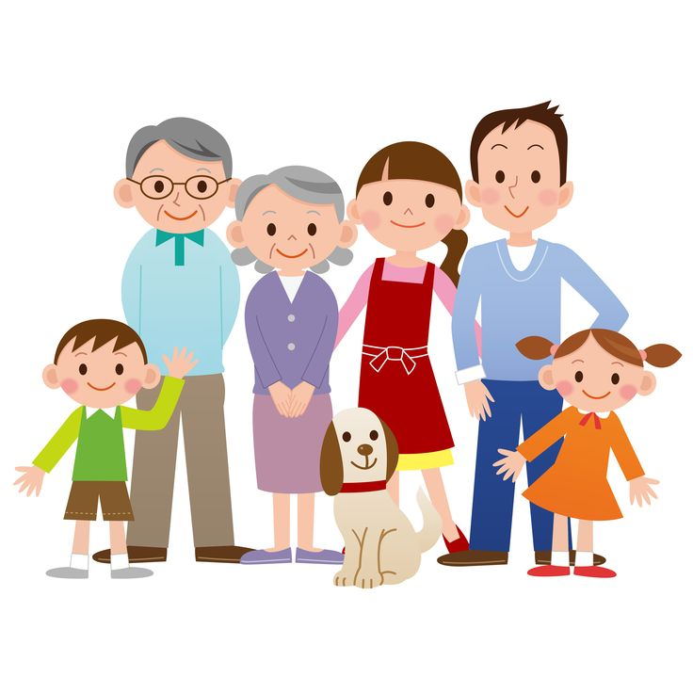
Rabies
German Measles
Diphtheria
Chickenpox
Meningococcal Disease
Tetanus
Hep A & B
Flu
Pneumoccal Disease
Mumps
Shingles
Typhoid
Whooping Cough
Measles
HPV
Vaccines are not just for babies
Older children and adults need protection too

Slide 3
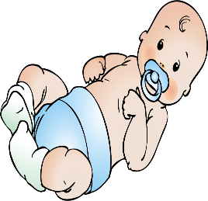
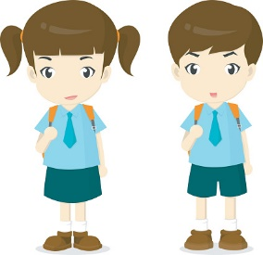
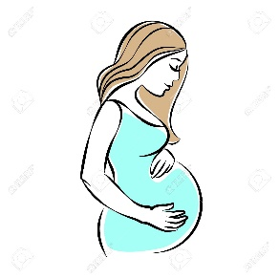
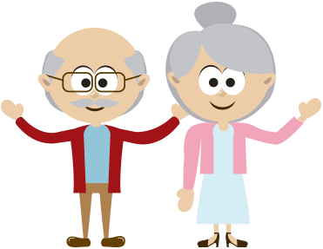
Babies
School children
Adults with or without comorbids
Doctors
recommend vaccination
Pregnant
Senior Citizens

Slide 4
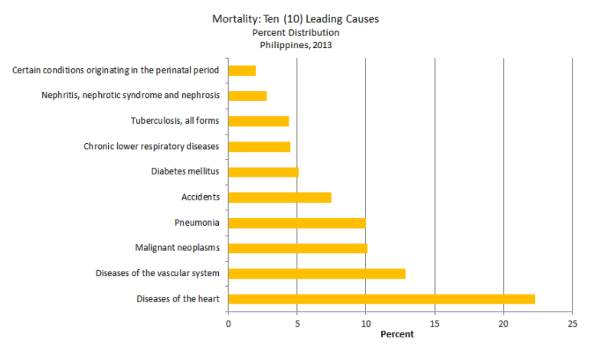
Pneumonia is one of the Leading Causes of Death in the Philippines
Notes:
Out of 514,745 deaths registered in 2013, more than 81 percent (433,375) were attributed to the top ten leading causes of death for the year. Deaths from all other causes comprised less than 20 percent of total deaths or 97,905 cases. More than one in every five deaths was caused by Diseases of the Heart making it the number one leading cause of death. Diseases of the Heart remained to be the first with 118,740 deaths. It recorded a 22.3 percent share from total deaths.
Diseases of the Heart had been consistently the number one cause of death for several years now. The 2013 number of deaths from this condition is 6,159 deaths (5.4%) higher than what was reported in 2012 which had 112,581 deaths. This year’s number of deaths from Diseases of the heart comprised 22.3 percent of total deaths. More males than females die from this cause. Out of 118,740 cases reported, 66,612 or 56 percent were males and 52,128 or 44 percent were females. Thus, the death sex ratio for Diseases of the Heart was 1.28 or 129 males in every 100 females.
The next three diseases in the list which remained in their respective rankings for the past four years already were, Diseases of the Vascular System (68,325; 12.9%), Malignant Neoplasm (53,601; 10.1%) and Pneumonia (53,101; 10.0%).
http://www.doh.gov.ph/mortality

Slide 5
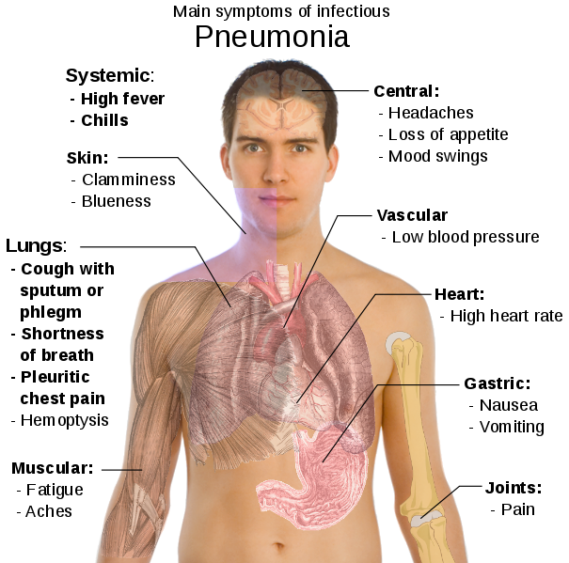
Symptoms of Pneumonia
Notes:
http://diseasespictures.com/wp-content/uploads/2014/03/Pneumonia.png
https://upload.wikimedia.org/wikipedia/commons/thumb/9/9f/Illu_conducting_passages.svg/1200px-Illu_conducting_passages.svg.png

Slide 6
Causes of Pneumonia
Pneumonia
Bacteria
Fungi
Viruses
http://www.who.int/mediacentre/factsheets/fs331/en/
Notes:
Examples of causative agents of pneumonia
Bacteria: Streptococcus pneumoniae, haemophilus influenza
Viral: respiratory syncytial virus
Pneumocystis carinii

Slide 7
One of the bacteria is Streptococcus pneumoniae
Illness due to Streptococcus pneumoniae:
Pneumonia
Tonsillitis
Sinusitis
Otitis Media
Meningitis
Notes:
These are the various diseases that can be a manifestation of infection with the bacteria called streptococcu pneumoniae.

Slide 8
Pneumonia
is not a severe type of colds or flu.

Slide 9
Pneumonia in the Elderly
Every year, worldwide, > 1,000,000 die from pneumonia and influenza
Has always been among the top 10 causes of mortality, especially if > 65 years old
It is costly for the patient’s family and the government
There are treatment options for pneumonia
It can be prevented
Notes:
At the other end of the spectrum, there are the elderly, whose age makes them at risk for pneumonia because of the decreased immune response system…. Even in the absence of other co-morbid conditions.

Slide 10
Pneumonia
is a serious infection which can affect anyone.

Slide 11
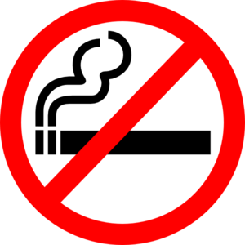
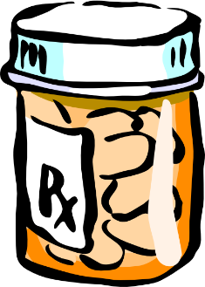
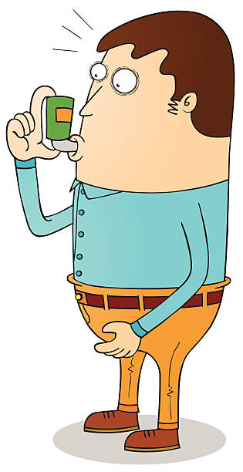
Who may be affected with pneumonia?
Smokers
Unnecessary antibiotic use
Malnourished
With other illnesses such as asthma, diabetes, heart diseases, kidney disease, cancer, HIV

Slide 12
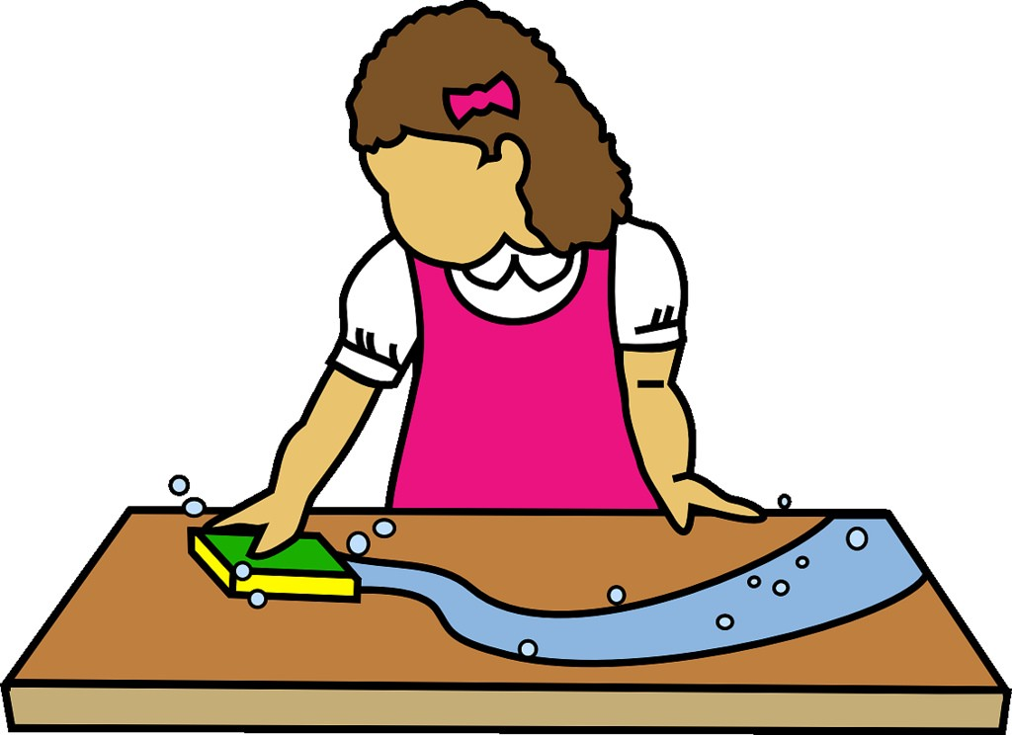
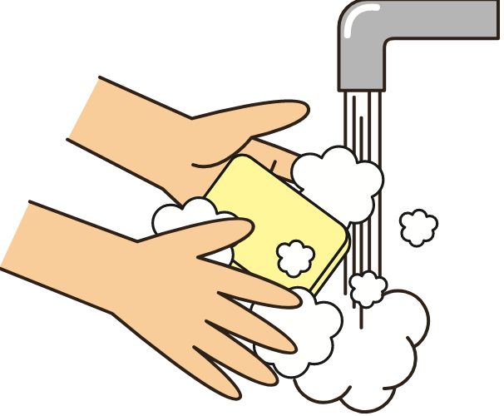
How to prevent pneumonia?
Good hygiene practices
REGULAR HAND WASHING
PROPER HOME HYGIENE
COVERING ONE’S MOUTH AND NOSE DURING COUGHING AND SNEEZING

Slide 13
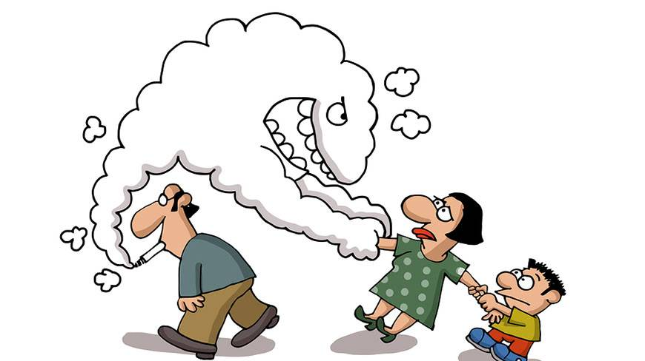
How to prevent pneumonia?
Stop smoking
Avoid secondhand smoke

Slide 14
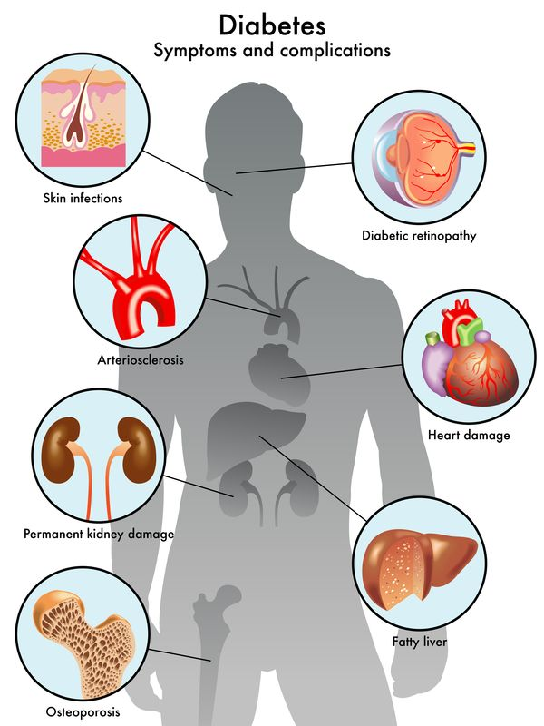
How to prevent pneumonia?
Regular check up especially for those with illnesses like asthma, diabetes

Slide 15
How to prevent pneumonia
Vaccination with pneumococcal vaccine

Slide 16
Pneumonia can be prevented effectively through vaccination.

Slide 17
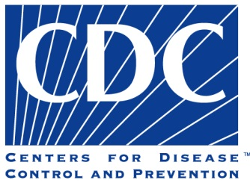
Vaccination against Pneumonia
Pneumonia is common in children. However, the elderly and those with chronic illnesses such as diabetes, heart disease are more prone to getting severe pneumonia.

Slide 18
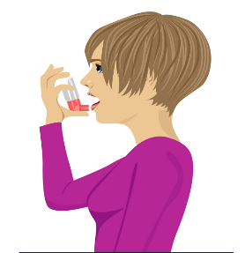
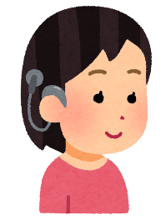
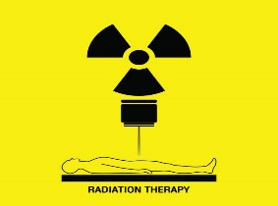
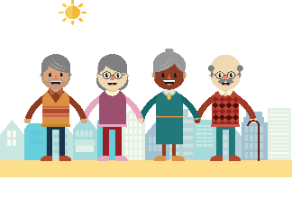
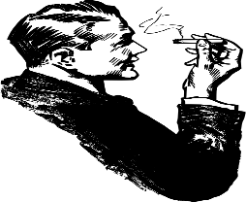
Adults who need pneumococcal vaccine
TB
Chronic lung conditions
Diabetes
Alcoholics
Cochlear implants
HIV
Radiotherapy
Chemotherapy
Nursing Home Residents
Smokers
PSMID, April 2017
Notes:
Target Individuals
Age 50 years and older without history of pneumococcal vaccination
Adults <50 years old with:
Chronic lung disease (including bronchial asthma, tuberculosis)
Chronic cardiovascular/renal/liver diseases
Diabetes mellitus
Alcoholism
Cochlear implants
CSF fluid leaks
Immunocompromised conditions:
Functional and anatomic asplenia
Leukemia and lymphomas
Generalized malignancy
Transplants
Chemo/radiation therapy
HIV/AIDS
Residents of nursing homes or long-term care facilities
Smokers

Slide 19
Who are not allowed to be vaccinated?
Those with allergy or hypersensitivity to the vaccine or any of its components.
Always make sure to consult your doctor

Slide 20
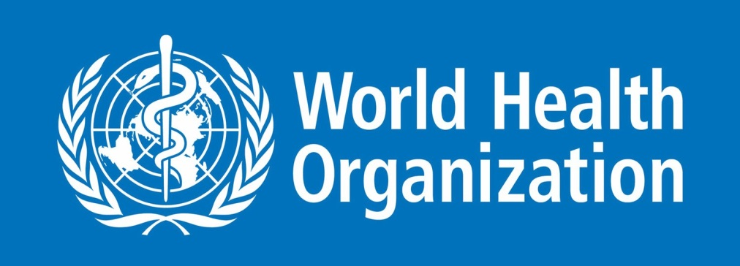
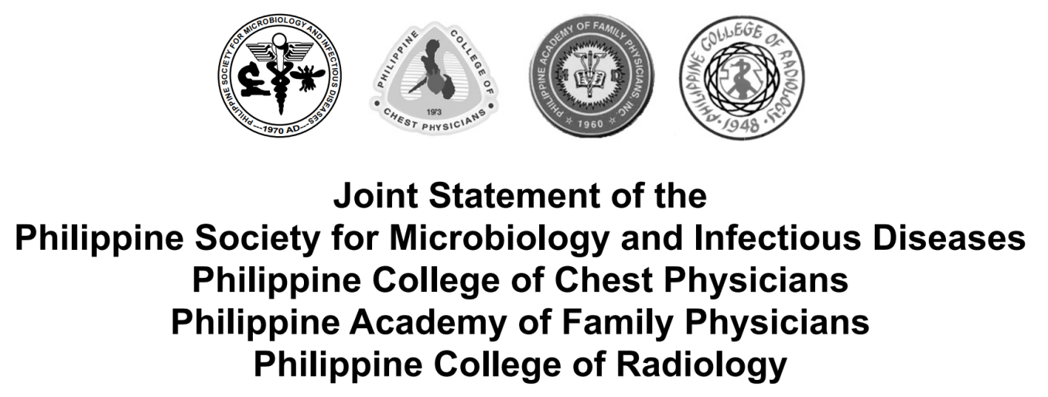
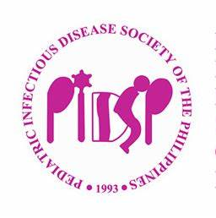
Vaccine Recommendation Against Pneumonia is done by Experts

Slide 21
Key points
Pneumonia is caused by viruses, fungi and bacteria
Streptococcus pneumoniae is the most common bacteria that causes pneumonia
Pneumococcal pneumonia is preventable by vaccination
Diabetic patients even before the age of 60 should have pneumococcal vaccine
Pneumococcal vaccine is available in health centers for senior citizens

Slide 22
Rabies
German Measles
Diphtheria
Chickenpox
Meningococcal Disease
Tetanus
Hep A & B
Flu
Pneumoccal Disease
Mumps
Shingles
Typhoid
Whooping Cough
Measles
HPV
Vaccines are not just for babies
Older children and adults need protection too

Slide 23
SALAMAT PO!

