Slide 1
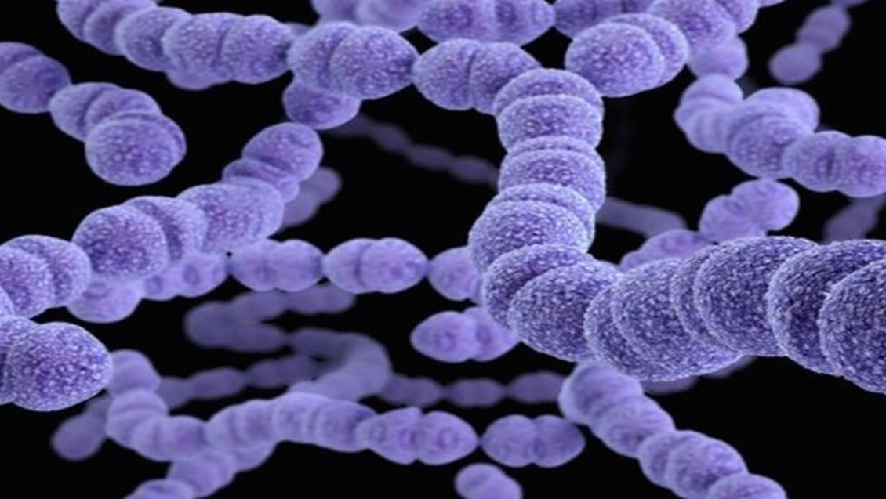
AGAPAN ang PULMONYA, MAGPABAKUNA
Speaker
Event
Date
PH-NON-00029

Slide 2
Disclosures
Speaker’s Photo
Speaker’s Name
Disclosures

Slide 3
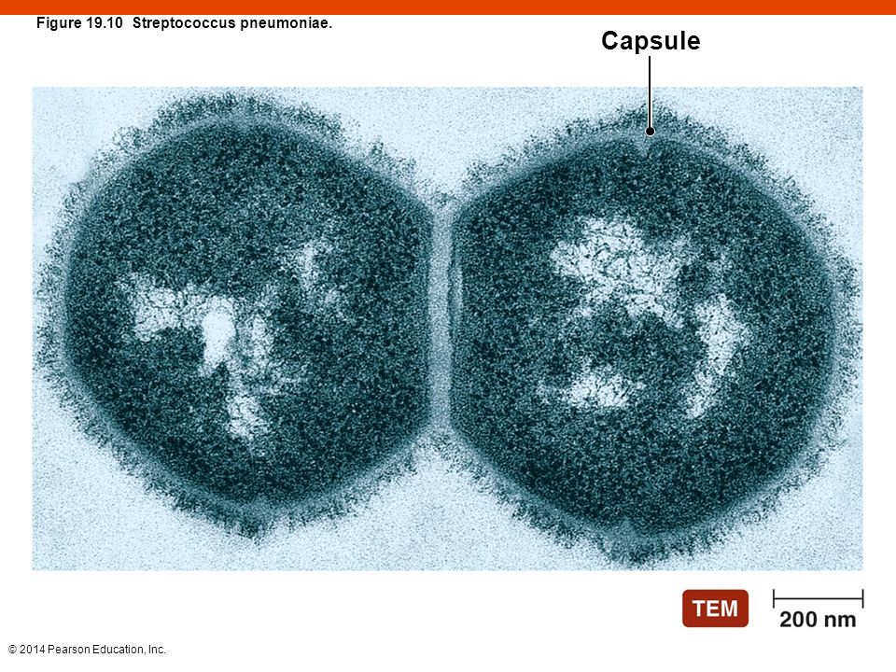
Ano ang Streptococcus pneumoniae?
Gram-positive diplococci with a polysaccharide capsule
Lynch JP. Curr Opin Pulm Med 2010;16(3):217-225
Notes:
Ay Streptococcus pneumoniae ay isang bacteria: Gram-positive diplococci with a polysaccharide capsule
May Higit sa 90 serotypes ang S pneumoniae.
Serotypes are grouped together based on immunological cross-reactivity
The capsule is an important virulent factor which defines immunologically distinct serotypes

Slide 4
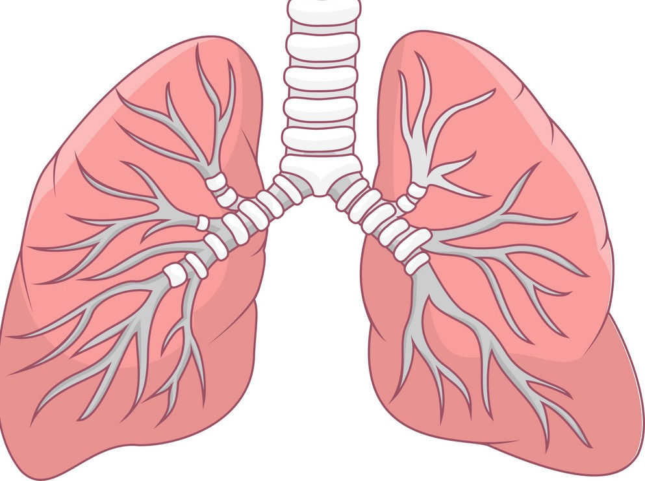
Ano ang pinaka pangkaraniwang sakit na dulot ng S. pneumoniae?
Sinusitis
Acute Otitis Media (impeksyon sa tenga)
Pulmonya
Bacteremia – impeksyon sa dugo
Meningitis – impeksyon sa lining ng utak
SEVERITY
The Remaining Challenges of Pneumococcal Disease in Adults. European Respiratory Review. 2012; 21: 123,57-65.
Cilloniz C, Torres A. Pneumococcal disease: Epidemiology and new vaccines. Community Acquir Infect [serial online] 2014 [cited 2016 Jul 8];1:35-43. Available from: http://www.caijournal.com/text.asp?2014/1/2/35/147647
Notes:
Pneumococcal diseases can be broadly divided into invasive and noninvasive disease. Invasive disease is diagnosed when Streptococcus pneumoniae is detected in normally sterile body fluids. Pneumonia can be invasive (bacteraemic) or noninvasive.
Most common pneumococcal disease = pneumococcal pneumonia.
The spectrum of disease in terms of severity and incidence is– where the most severe form is meningitis and most common is sinusitis. (more common pneumococcal disease, less severe. Less common pneumococcal disease, more severe)
Non-invasive: acute otitis media, sinusitis
Invasive: meningitis, bacteremia, pneumonia.

Slide 5
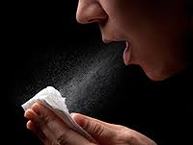
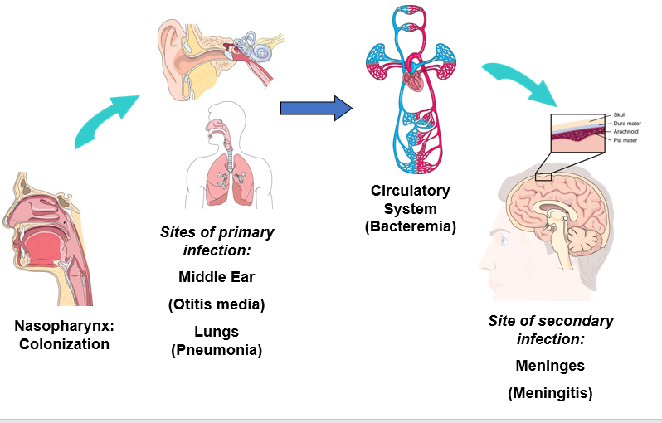
Paano nagkakaroon ng Pulmonya?
Infected aerosol (ubo, hatsing)
OR
Nasopharyngeal Carriers
Cilloniz C, Torres A. Pneumococcal disease: Epidemiology and new vaccines. Community Acquir Infect [serial online] 2014 [cited 2016 Jul 8];1:35-43.
Available from: http://www.caijournal.com/text.asp?2014/1/2/35/147647
Notes:
s. Pneumponiae causes invasive and noninvasive infections. NP colonization is necessary but not sufficient to cause pneumococcal disease. Indeed, colonization with most pneumococcal serotypes is asymptomatic and does NOT result in disease.
A minority of pneumococcal bacteria causing NP colonization go on to spread to other sites, thus causing disease.
For very invasive serotypes of pneumococcus, the transit time through the NP mucosa may be very quick.
One route of spread is through the respiratory tract to cause acute otitis media or pneumonia.
Pneumococcus may also spread from the nasopharynx to the blood (bacteremic stage) and then cause distal, focal disease such as meningitis.

Slide 6
Gaano kabigat magkaroon ng pulmonya?
Most common cause of confinement/claims
3rd
^{Leading cause of death}
P 250,000
Cost of confinement
Mga komplikasyon
1Economic Burden of Community-Acquired Pneumonia Among Adults In The Philippines Its Clinical and Policy Implications in the Case, Rate Payments of The Philippine Health Insurance Corporation, Tumanan-Mendoza B.A, et al, valueinhealthjournal.com; 1098-3015(15)01426-6.
Notes:
Community-acquired pneumonia is the most common diagnosis for claims with Philhealth
Pneumonia is the 3rd leading cause of death in the Philippines after cardiovascular disease and malignancies.
Cost of confinement for pneumonia ranges from Php 35,000 to Php 250,000.

Slide 7
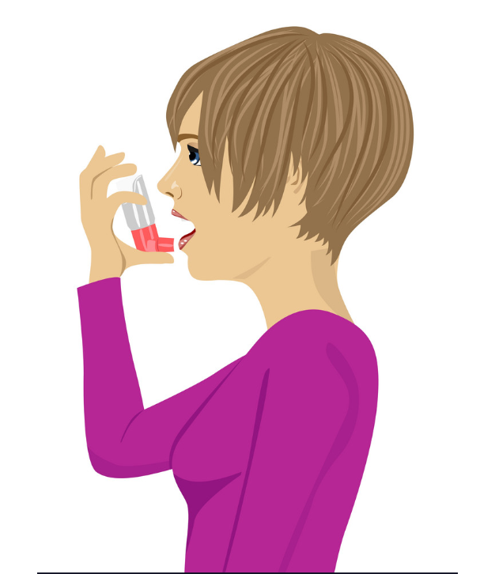
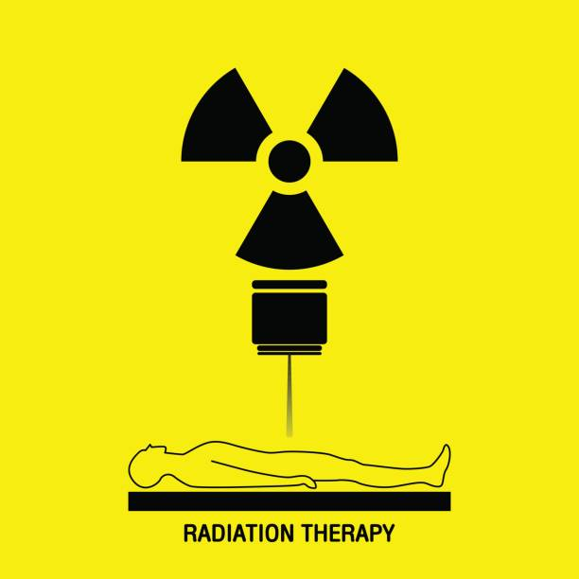
Ikaw ba ay isa sa mga sumusunod?
TB
Chronic lung conditions
Diabetes
Alcoholics
Cochlear implants
HIV
Radiotherapy
Chemotherapy
Nursing Home Residents
Smokers
PSMID, April 2017
Notes:
Target Individuals
Age 50 years and older without history of pneumococcal vaccination
Adults <50 years old with:
Chronic lung disease (including bronchial asthma, tuberculosis)
Chronic cardiovascular/renal/liver diseases
Diabetes mellitus
Alcoholism
Cochlear implants
CSF fluid leaks
Immunocompromised conditions:
Functional and anatomic asplenia
Leukemia and lymphomas
Generalized malignancy
Transplants
Chemo/radiation therapy
HIV/AIDS
Residents of nursing homes or long-term care facilities
Smokers

Slide 8
Ikaw ba ay isa sa mga sumusunod?
Kung OO, kailangan mo ng bakuna para maiwasa ang pulmonya
TB
Chronic lung conditions
Diabetes
Alcoholics
Cochlear implants
HIV
Radiotherapy
Chemotherapy
Nursing Home Residents
Smokers
PSMID, April 2017
Notes:
Target Individuals
Age 50 years and older without history of pneumococcal vaccination
Adults <50 years old with:
Chronic lung disease (including bronchial asthma, tuberculosis)
Chronic cardiovascular/renal/liver diseases
Diabetes mellitus
Alcoholism
Cochlear implants
CSF fluid leaks
Immunocompromised conditions:
Functional and anatomic asplenia
Leukemia and lymphomas
Generalized malignancy
Transplants
Chemo/radiation therapy
HIV/AIDS
Residents of nursing homes or long-term care facilities
Smokers

Slide 9
Bakit kailangan ng bakuna sa pulmonya ng mga sumusunod?
Dahil mas mataas ang posibilidad na magkaron ng pulmonya
kung ikaw ay isa sa mga sumusunod
TB
Chronic lung conditions
Diabetes
Alcoholics
Cochlear implants
HIV
Radiotherapy
Chemotherapy
Nursing Home Residents
Smokers
PSMID, April 2017
Notes:
Target Individuals
Age 50 years and older without history of pneumococcal vaccination
Adults <50 years old with:
Chronic lung disease (including bronchial asthma, tuberculosis)
Chronic cardiovascular/renal/liver diseases
Diabetes mellitus
Alcoholism
Cochlear implants
CSF fluid leaks
Immunocompromised conditions:
Functional and anatomic asplenia
Leukemia and lymphomas
Generalized malignancy
Transplants
Chemo/radiation therapy
HIV/AIDS
Residents of nursing homes or long-term care facilities
Smokers

Slide 10
Kung ikaw ay DIABETIC
Mahalaga na magpabakuna laban sa pneumonia
Ikaw ay may mataas na RISK ng pagkakaroon ng pneumonia
Diabetes

Slide 11
Schedule
At least 1 YEAR
☑ PPSV23
PCV 13
At least 1 YEAR
At least 1 YEAR
☑ PPSV23
PCV 13
PPSV23
< 50 years old
> 50 years old
5 YEARS
☑ PPSV23
PPSV23
REVACCINATION
At least 1 YEAR
PCV 13
PPSV23
NONE
Notes:
Slides 10 and 11 are alternate slides.

Slide 12
2017 Adult Immunization Guideline
(as of June 2017)
BAKUNA | MGA DAPAT BAKUNAAN
1. Conjugate (PCV13) Intramuscular 2. Polysaccharide (PPSV23) Intramuscular or Subcutaneous | Edad 50 taong gulang na di pa nababakunaan Mas matanda sa 50 taong gulang pero may sumusunod namga sakit: Chronic lung disease (tulad ng hika at TB) Chronic cardiovascular/renal/liver diseases (puso, bato, atay) Diabetes mellitus Alcoholism Cochlear implants CSF fluid leaks Immunocompromised conditions: Functional and anatomic asplenia Leukemia and lymphomas Generalized malignancy Transplants Chemo/radiation therapy HIV/AIDS Residents of nursing homes or long-term care facilities Smokers
Reference: Schedule for Adult Immunization 2017 , Philippine Society for Microbiology and Infectious Diseases (PSMID), and Philippine Foundation for Vaccination (PFV) Updated as of April 2017
Notes:
In passing

Slide 13
2017 Adult Immunization Guideline
(as of June 2017)
Schedule (Adults)
Walang bakuna | Bigyan ng PCV 13. Pagkaraan ng 1 taon, bigyan ng PPSV 23
Nabakunaan na ng PPSV 23 | Bigyan ng PCV 13 pagkaraan ng 1 taon
Nabakunaan ng PPSV 23 bago nag 50 years old, at lampas 50 na sa kasalukuyan | Bigyan ng PCV 13. Pagkaraan ng 1 taon, bigyan ng PPSV 23
Revaccination | Maaring bigyan ng PPSV 23 5 taon pagkalipas ng huling pagbakuna ng PPSV
Reference: Schedule for Adult Immunization 2017 , Philippine Society for Microbiology and Infectious Diseases (PSMID), and Philippine Foundation for Vaccination (PFV) Updated as of April 2017
Notes:
No previous vaccination:
PCV 13 first, followed by PPSV23 at least 1 year after the PCV13 dose
Previously received PPSV23:
should receive PCV13 to be given at least 1 year after the dose of PPSV23
Previously received PPSV23 at less than 50 years old, but who are now 50 years old or more:
1 dose of PCV13 at least 1 year after the most recent dose of PPSV23, then 1 dose of PPSV23 after 1 year of the PCV13 dose
Revaccination
1 dose PPV23 maybe given 5 years after last dose of PPV23

Slide 14
Ano pa ang ibang bakunang kailangan?
Pneumococcal
Diabetes
Flu
Zoster
Heart diseases
Lung diseases
Hep B
TDaP
https://www.cdc.gov/vaccines/hcp/adults/downloads/fs-asthma-vaccines.pdf
https://www.cdc.gov/vaccines/hcp/adults/downloads/fs-diabetes-vaccines.pdf
https://www.cdc.gov/vaccines/hcp/adults/downloads/fs-heart-disease-vaccines.pdf
Accessed Nov 30 2018

Slide 15
May mga handang tumulong sa iyo tungkol sa bakuna! Ang bakuna sa pulmonya ay mahalaga! Ang bakuna ay ligtas!
Notes:
Call to action

Slide 16
AGAPAN ang PULMONYA, MAGPABAKUNA!
Salamat sa pakikinig!
May katanungan po kayo?

Slide 17
Salamat sa pakikinig
May katanungan po kayo?

Slide 18
Selected Safety Information
Do not administer PNEUMOVAX 23 to individuals with a history of a hypersensitivity reaction to any component of the vaccine.
Defer vaccination with PNEUMOVAX 23 in persons with moderate or severe acute illness.
Use caution and appropriate care in administering PNEUMOVAX 23 to individuals with severely compromised cardiovascular and/or pulmonary function in whom a systemic reaction would pose a significant risk.
PNEUMOVAX 23 should be given to a pregnant woman only if clearly needed.
Caution should be exercised when PNEUMOVAX 23 is administered to a nursing woman.
Since elderly individuals may not tolerate medical interventions as well as younger individuals, a higher frequency and/or a greater severity of reactions in some older individuals cannot be ruled out.
Persons who are immunocompromised, including persons receiving immunosuppressive therapy, may have a diminished immune response to PNEUMOVAX 23.

Slide 19
Selected Safety Information
PNEUMOVAX 23 may not be effective in preventing pneumococcal meningitis in patients who have chronic cerebrospinal fluid (CSF) leakage resulting from congenital lesions, skull fractures, or neurosurgical procedures.
The most common adverse reactions, reported in >10% of subjects vaccinated with PNEUMOVAX 23 in clinical trials, were: injection-site pain/soreness/tenderness, injection-site swelling/induration, headache, injection-site erythema, asthenia and fatigue, and myalgia.
For subjects aged 65 years or older in a clinical study, systemic adverse reactions which were determined by the investigator to be vaccine-related were higher following revaccination than following initial vaccination.
Vaccination with PNEUMOVAX 23 may not offer 100% protection from pneumococcal infection.

Slide 20
Selected Safety Information
INDICATION
PNEUMOVAX®23 (Pneumococcal Vaccine Polyvalent) is a vaccine indicated for active immunization for the prevention of pneumococcal disease caused by the 23 serotypes contained in the vaccine (1, 2, 3, 4, 5, 6B, 7F, 8, 9N, 9V, 10A, 11A, 12F, 14, 15B, 17F, 18C, 19F, 19A, 20, 22F, 23F, and 33F).
PNEUMOVAX 23 is approved for use in persons 50 years of age or older and persons aged ≥2 years who are at increased risk for pneumococcal disease.
PNEUMOVAX 23 will not prevent disease caused by capsular types of pneumococcus other than those contained in the vaccine.
Before administering PNEUMOVAX®23 (Pneumococcal Vaccine Polyvalent), please read the Prescribing Information.

