Slide 1
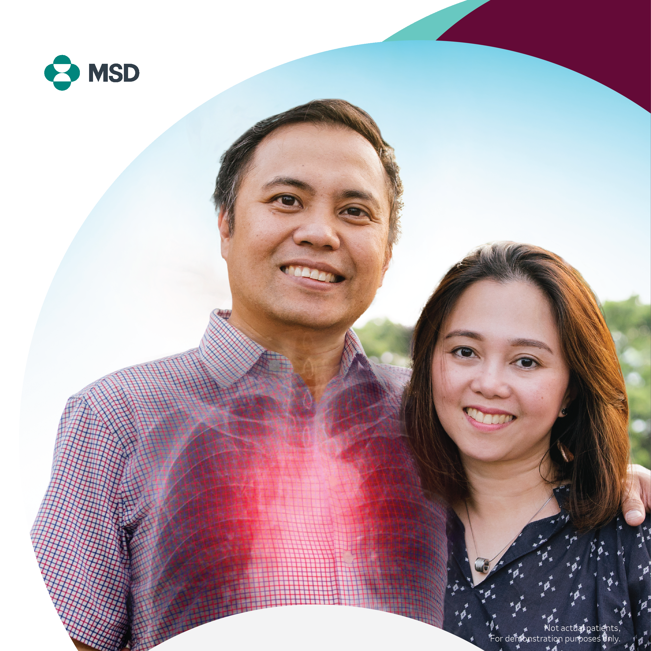
A Guide to
Protecting Patients from
PNEUMONIA
PH-NON-00774 Feb/2024

Slide 2

Discussion Outline
What is Streptococcus pneumoniae?
What is Pneumonia?
Who are at Risk?
Pneumococcal Vaccine Types
Adult Immunization Guidelines
COVID and Non-COVID Vaccine Interval
Managing Adverse Events

Slide 3
What is
Streptococcus pneumoniae?

Slide 4
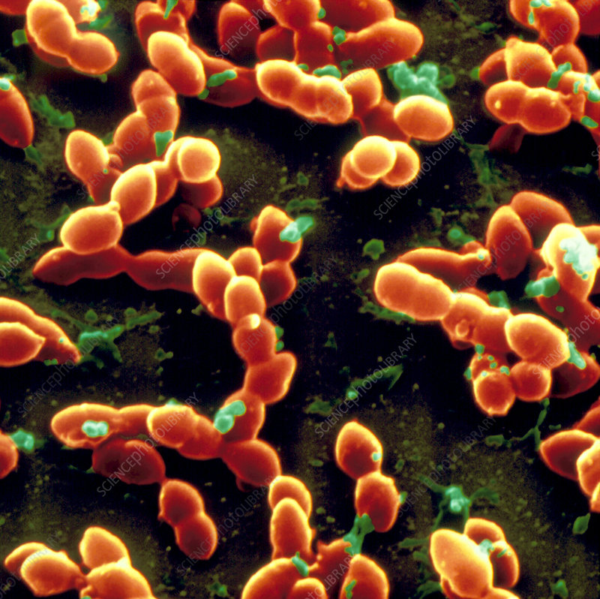
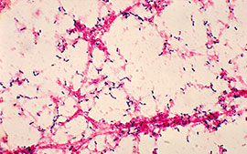
Streptococcus pneumoniae
Lancet-shaped, gram-positive, facultative anaerobic bacteria with more than 100 known serotypes
A polysaccharide capsule surrounds the bacterium and is an important virulent factor which defines immunologically distinct serotypes
        Forms the basis for many current bacterial vaccines
Uptodate. 2022. Microbiology and Pathogenesis of Streptococcus pneumonia
Streptococcus pneumoniae: Information for Clinicians | CDC
Notes:
Streptococcus pneumoniae occupies an important position in the history of microbiology:
The first recognition that antibody directed to the capsular polysaccharide of a bacteria could be protective was shown for the pneumococcus; this observation forms the basis for many current bacterial vaccines.

Slide 5
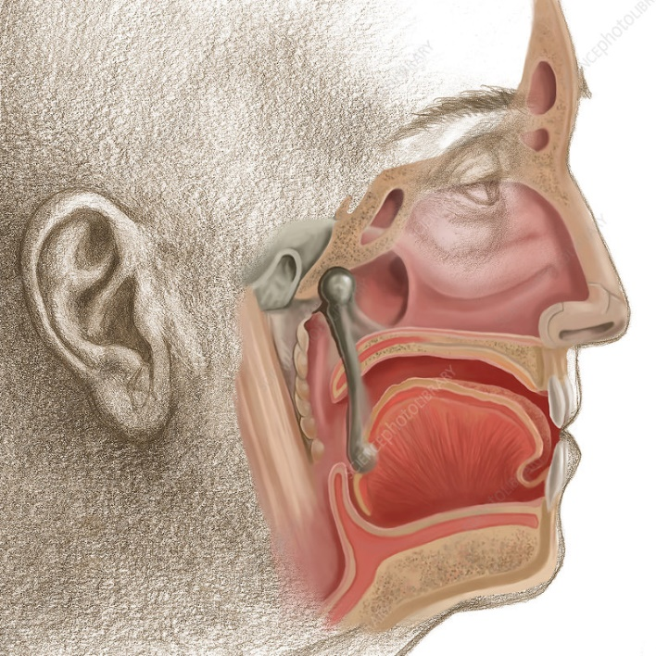
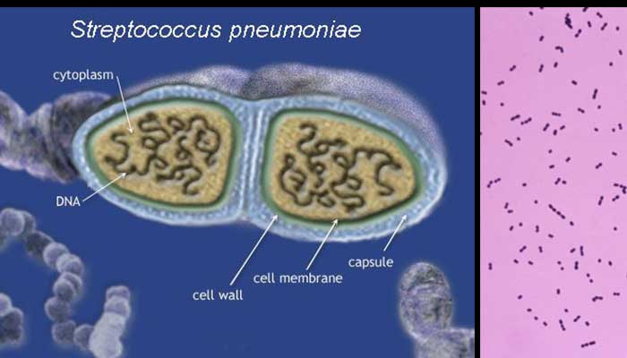
Streptococcus pneumoniae
S. pneumoniae is a human pathogen.
Reservoir: nasopharynx of asymptomatic humans.
        There is no animal or insect vector.
Transmission: direct person-to-person contact via respiratory droplets or by autoinoculation
Clustering in family:
        Crowding
        Season
        Presence of upper respiratory infections or otitis media
Pinkbook: Pneumococcal Disease | CDC
Notes:
S. pneumoniae is a human pathogen. The reservoir for pneumococci is the nasopharynx of asymptomatic humans. There is no animal or insect vector.
Transmission of S. pneumoniae occurs as the result of direct person-to-person contact via respiratory droplets or by autoinoculation in persons carrying the bacteria in their upper respiratory tract.
The spread of the organism within a family or household is influenced by such factors as household crowding and viral respiratory infections.

Slide 6
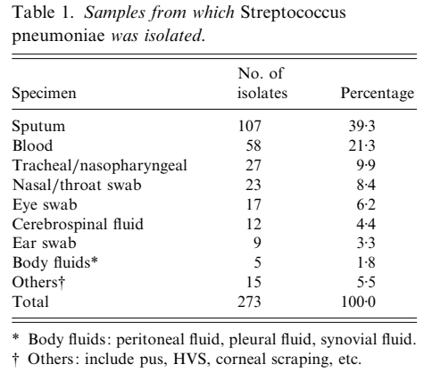
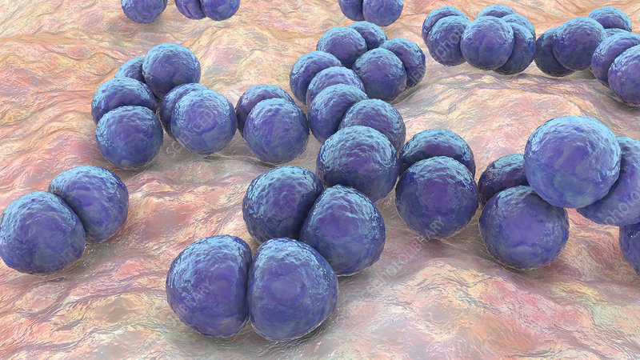
Streptococcus pneumoniae
Rohani MY. Et al Epidemiology of Streptococcus pneumoniae infection in Malaysia. Epidemiol. Infect. (1999), 122, 77–82
Notes:
Pneumonia most common presenting manifestation of pneumococcal disease

Slide 7
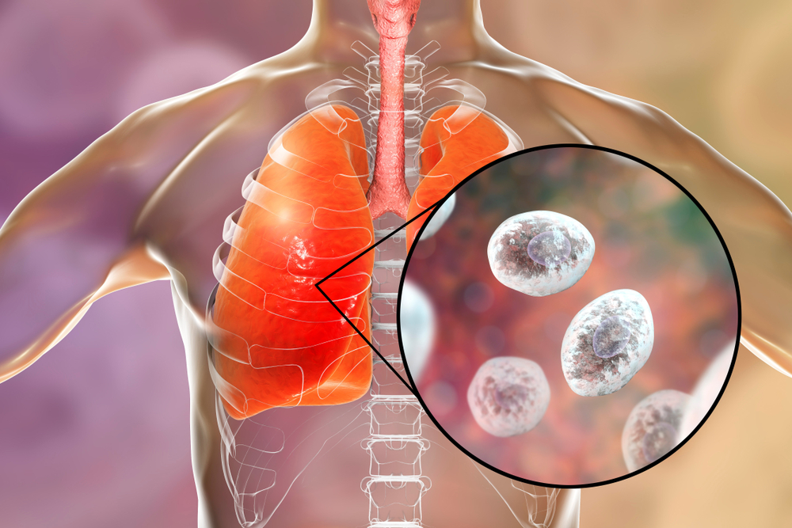
Streptococcus pneumoniae
Most common cause of pneumonia
Most common bacterial cause of community-acquired pneumonia (CAP) leading to hospitalization of adults today
Heffron R. Symptoms of lobar pneumonia in Pneumonia with special reference to pneumococcus lobar pneumonia, Harvard University Press, Cambridge 1939
Notes:
Pneumococcus has historically been the most common cause of pneumonia, by far [1], and remains the most common bacterial cause of community-acquired pneumonia (CAP) leading to hospitalization of adults today.

Slide 8
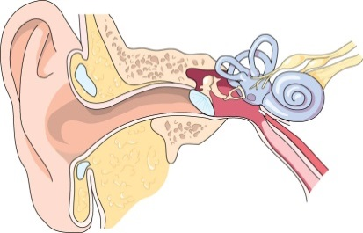
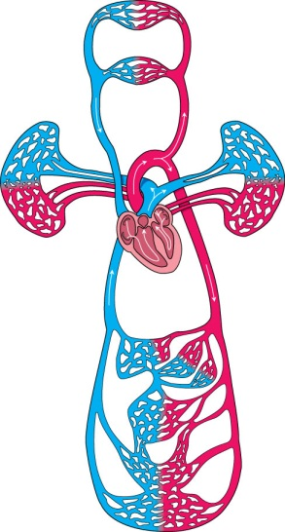
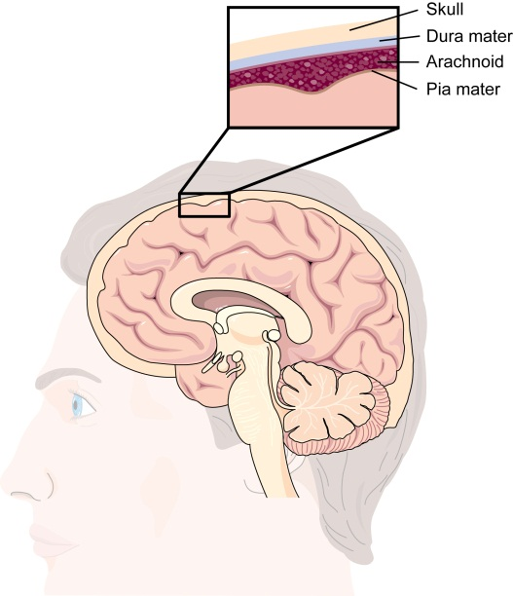
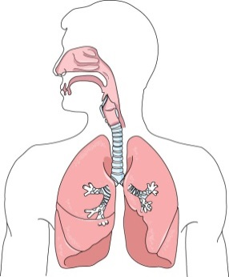
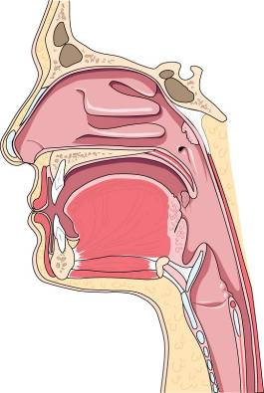
Pneumococcal Disease
Transmission and Progression of Disease
Circulatory
System
(bacteremia)
Sites of primary infection:
Middle Ear (otitis media, sinusitis)
Lungs (pneumonia)
Nasopharynx: Colonization
Site of secondary infection: Meninges (meningitis)
Musher DM. Streptococcus pneumoniae. In: Mandell GL, Bennet JE, Dolin R. Principles and Practice of Infectious Diseases. 7th ed. Philadelphia. Churchhill Livingstone Elsevier Co; 2010:2623–2642.

Slide 9
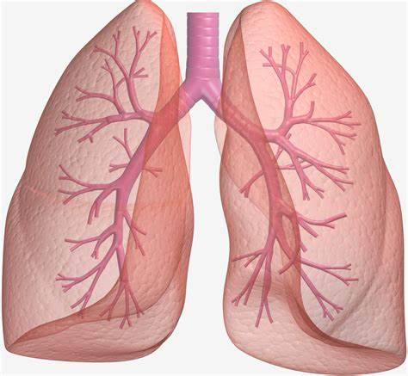

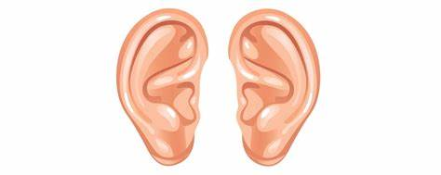

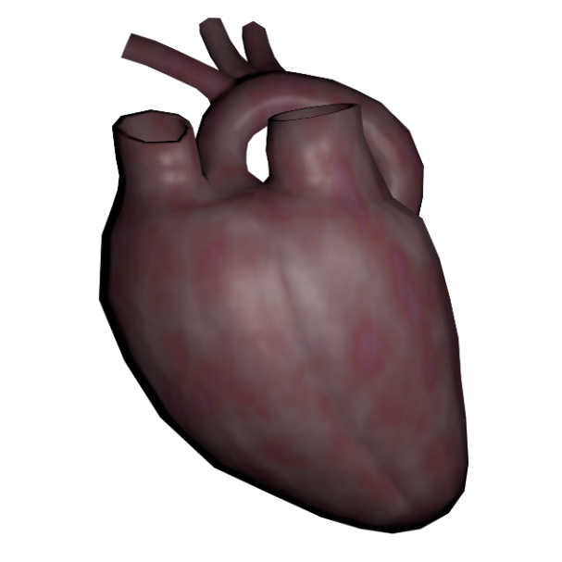
Pneumonia
Otitis media
Streptococcus pneumoniae
Meningitis
Uptodate. 2022. Microbiology and Pathogenesis of Streptococcus pneumonia
Musher B et al. The association between pneumococcal pneumonia and acute cardiac events. Clin Infect Dis. 2007;45(2):158.
Acute cardiac event
Notes:
Non invasive and Invasive pneumococcal disease
Pneumococcus is a major cause of infection in children and older adults. Manifestations range from asymptomatic nasopharyngeal carriage to otitis media, pneumonia, sepsis, and meningitis.
Patients with pneumococcal pneumonia are at substantial risk for a concurrent acute cardiac event, such as MI, serious arrhythmia, or new or worsening CHF. This concurrence significantly increases mortality due to pneumonia.

Slide 10
Kinds of Pneumococcal Disease
Pneumococcal Disease
INVASIVE
MENINGITIS
PNEUMONIA
NONINVASIVE
(MUCOSAL)
ACUTE OTITIS MEDIA
BACTEREMIA
SINUSITIS
SEVERITY
The Remaining Challenges of Pneumococcal Disease in Adults. European Respiratory Review. 2012; 21: 123,57-65.
Cilloniz C, Torres A. Pneumococcal disease: Epidemiology and new vaccines. Community Acquir Infect [serial online] 2014 [cited 2016 Jul 8];1:35-43. Available from: http://www.caijournal.com/text.asp?2014/1/2/35/147647

Slide 11
What is PNEUMONIA?

Slide 12

Pneumonia
Can range in seriousness from mild to life-threatening
Most serious for:
  Infants and young children,
  People older than age 65, and
  People with health problems / chronic medical conditions, or weakened immune system
Source/s: https://www.mayoclinic.org/diseases-conditions/pneumonia/symptoms-causes/syc-20354204

Slide 13
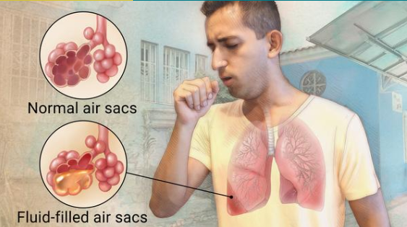
Pneumonia
Causes cough with phlegm or pus, fever, chills, and difficulty breathing
However, can also present with just fever, general feeling of discomfort and headache rather than respiratory symptoms
Source/s: https://www.mayoclinic.org/diseases-conditions/pneumonia/symptoms-causes/syc-20354204

Slide 14



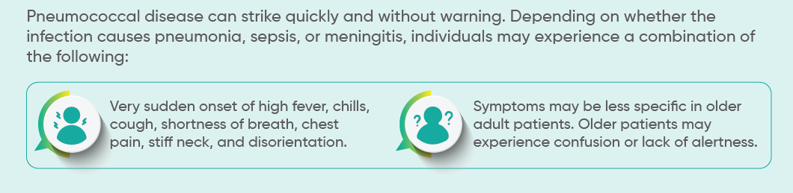
Symptoms
Source/s: https://www.mayoclinic.org/diseases-conditions/pneumonia/symptoms-causes/syc-20354204

Slide 15
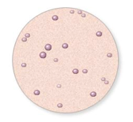
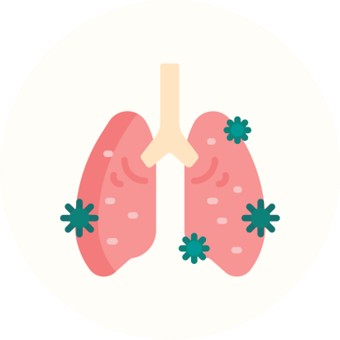
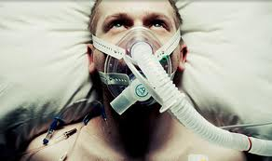
Complications
Even with treatment, some people with pneumonia, especially those in high-risk groups, may experience complications, including:
Bacteria in the bloodstream (bacteremia). Bacteria that enter the bloodstream from your lungs can spread the infection to other organs, potentially causing organ failure.
Difficulty breathing. If your pneumonia is severe or you have chronic underlying lung diseases, you may have trouble breathing in enough oxygen. You may need to be hospitalized and use a breathing machine (ventilator) while your lung heals.
Fluid accumulation around the lungs (pleural effusion). Pneumonia may cause fluid to build up in the thin space between layers of tissue that line the lungs and chest cavity (pleura). If the fluid becomes infected, you may need to have it drained through a chest tube or removed with surgery.
Lung abscess. An abscess occurs if pus forms in a cavity in the lung. An abscess is usually treated with antibiotics. Sometimes, surgery or drainage with a long needle or tube placed into the abscess is needed to remove the pus.
Source/s: https://www.mayoclinic.org/diseases-conditions/pneumonia/symptoms-causes/syc-20354204

Slide 16
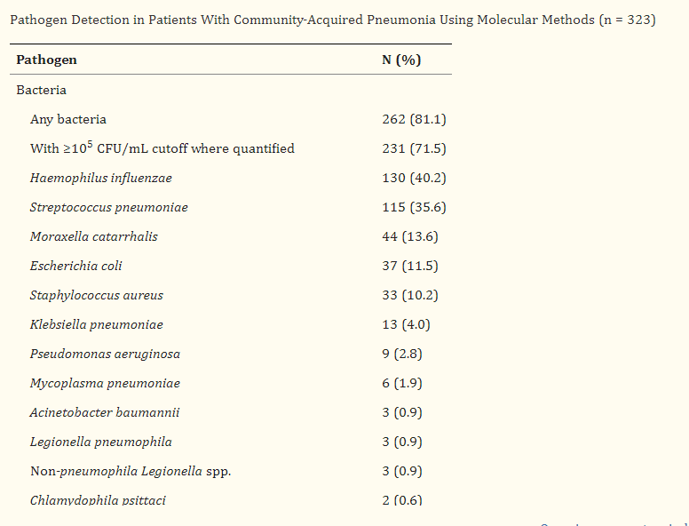
Epidemiology
Gadsby et al. Comprehensive Molecular Testing for Respiratory Pathogens in Community-Acquired Pneumonia. Clin Infect Dis. 2016;62(7):817. Epub 2016 Jan 7
Notes:
USA data

Slide 17
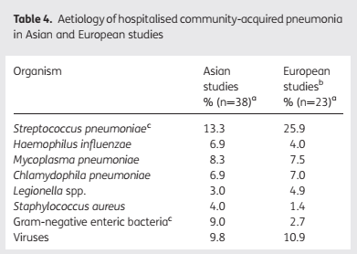
Epidemiology
Peto et al. The bacterial aetiology of adult community-acquired pneumonia in Asia: a systematic review. Trans R Soc Trop Med Hyg 2014; 108: 326–337
Notes:
ASIAN and European data
Even as other causative organisms of CAP were demonstrated (eg, influenza, Mycoplasma, other respiratory viruses, Haemophilus, Moraxella, and Chlamydia spp), pneumococcus continued to be the major cause of pneumonia in adults through the 1960s. Studies since then have shown a declining proportion of pneumonia to be due to this organism

Slide 18
Mortality with pneumococcal pneumonia
12 – 15% : Admitted for bacteremic pneumococcal pneumonia
25% : 90 day mortality
RISK FACTORS:
Age > 65
Residence in nursing home
Presence of chronic lung disease
HIV
Renal failure / dialysis patients
Moderate to severe liver disease
Bilateral disease
Need for mechanical ventilation
Through the years, there was actual decline in numbers of Streptococcus pneumoniae
Musher DM. Bacteremic and nonbacteremic pneumococcal pneumonia. A prospective study. Medicine (Baltimore). 2000;79(4):210.
Brandenburg. Clinical presentation, processes and outcomes of care for patients with pneumococcal pneumonia. J Gen Intern Med. 2000;15(9):638
Notes:
Factors that have contributed to the decline in S. pneumoniae as a cause of CAP include the widespread acceptance of pneumococcal vaccines by adults, a substantial reduction in cigarette smoking by adults (these two factors likely distinguish the United States from Europe), and the universal use of pneumococcal conjugate vaccines in children.
Comorbid conditions are a significant predictor of poor outcome in bacteremic pneumococcal disease.

Slide 19
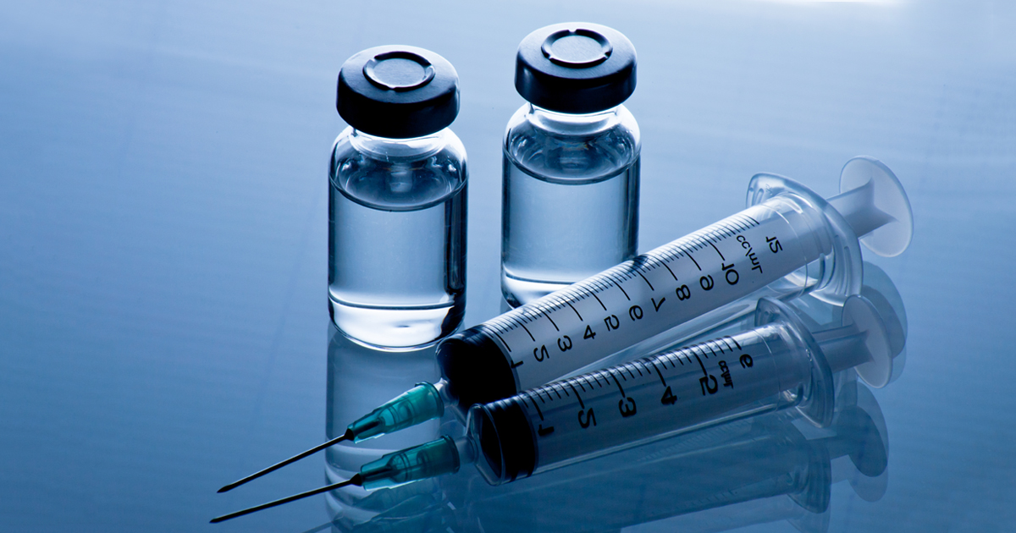
Factors that affect the decline in Streptococcus pneumoniae
Widespread acceptance of pneumococcal vaccines by adults
A substantial reduction in cigarette smoking by adults
Universal use of pneumococcal conjugate vaccines in children
Uptodate 2022. Pneumococcal pneumonia in patients requiring hospitalization
Notes:
Factors that have contributed to the decline in S. pneumoniae as a cause of CAP include the widespread acceptance of pneumococcal vaccines by adults, a substantial reduction in cigarette smoking by adults (these two factors likely distinguish the United States from Europe), and the universal use of pneumococcal conjugate vaccines in children.

Slide 20
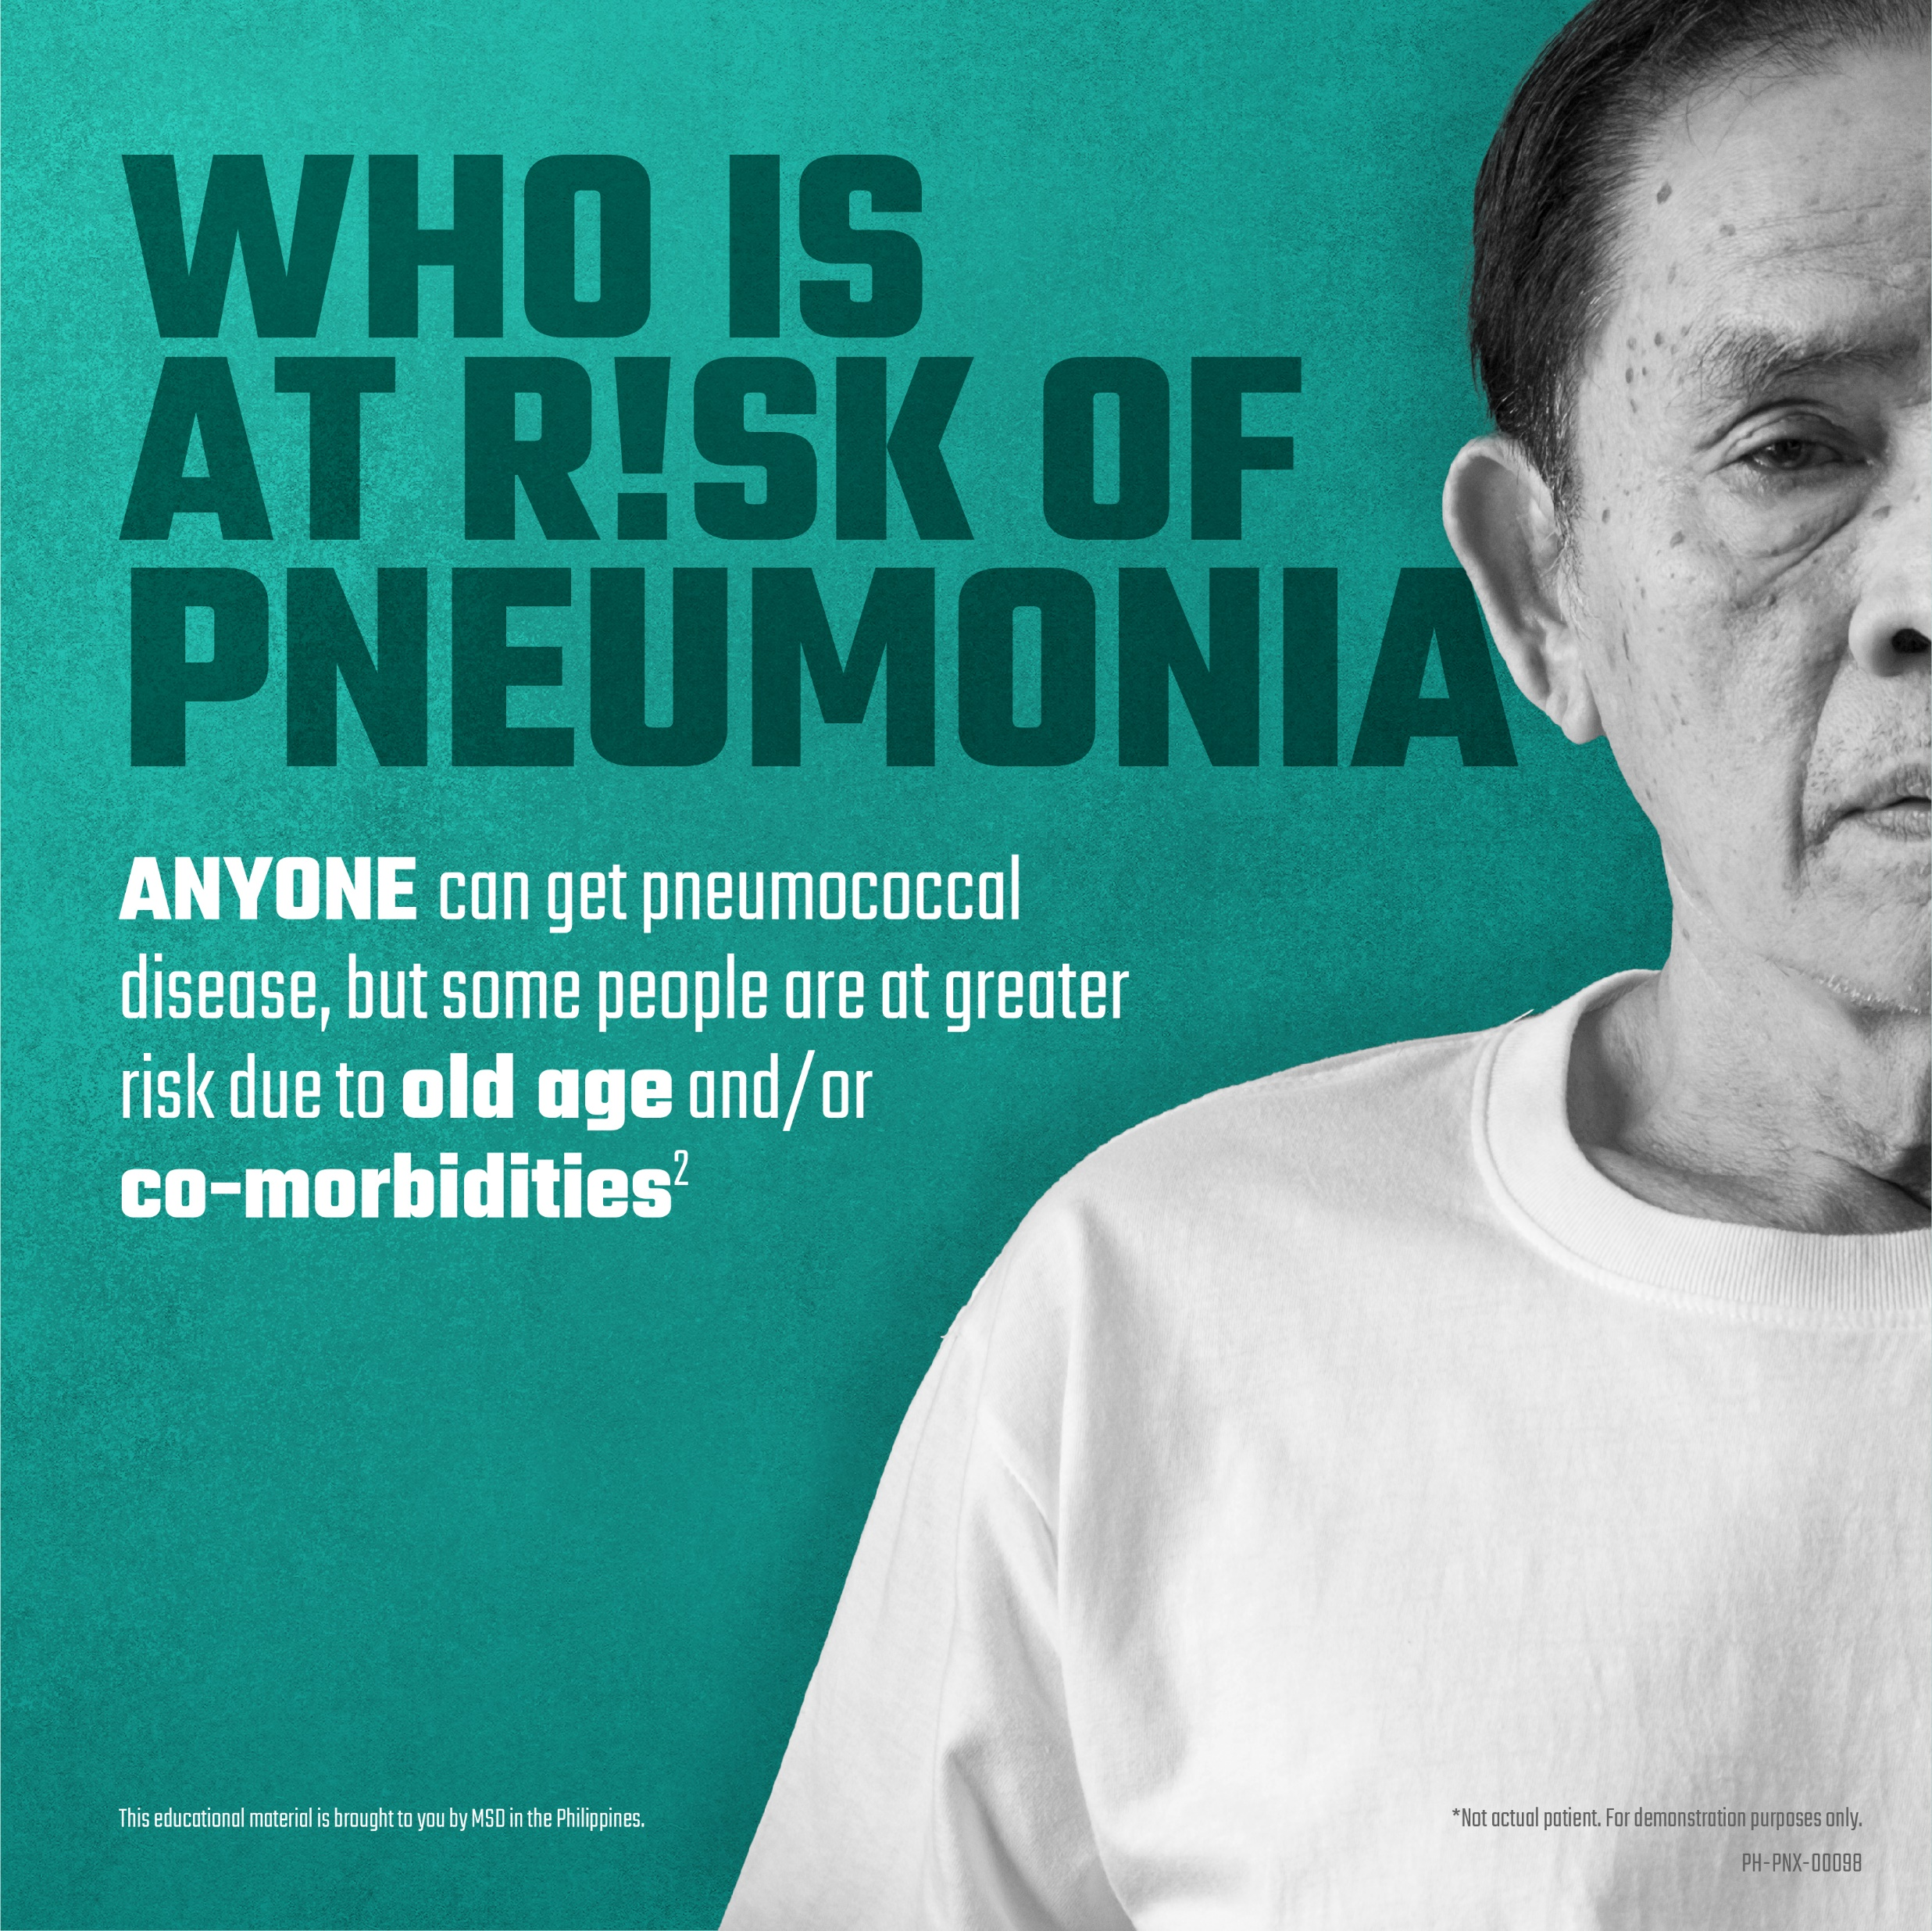
Who are at risk?

Slide 21
Pneumococcal disease presents differently in children and adults
CHILDREN
Meningitis
Bacteremia/
Sepsis
Pneumococcal Pneumonia
Pneumonia
Acute Otitis
Media
1. Centers for Disease Control and Prevention. Pneumococcal disease. In: Atkinson W, et al, eds. Epidemiology and Prevention of Vaccine-Preventable Diseases. 12th ed., second printing. Washington, DC: Public Health Foundation; 2012:233-248. 2. Huang SS, et al. Vaccine. 2011;29:3398-3412. 3. Said MA, et al. PLoS ONE. 2013;8:e60273.
Notes:
Key Points
Pneumococcal disease presents differently in children and adults.
In young children, acute otitis media is by far the most common presentation of pneumococcal disease.
In adults, pneumococcal pneumonia constitutes the vast majority of disease.
Notes
Pneumococci are identified in approximately 28% to 55% of acute otitis media cases.¹
According to modeling based on 2004 statistics, nonbacteremic pneumonia affects more than 440,000 adults aged 50 years and older in the United States.²
Based on data from a systematic literature review and meta-analysis of community-acquired pneumonia studies reporting pneumococcal detection, Said et al estimated that 25% of pneumococcal pneumonia cases are bacteremic.³
References
Centers for Disease Control and Prevention. Pneumococcal disease. In: Atkinson W, Wolfe S, Hamborsky J, eds. Epidemiology and Prevention of Vaccine-Preventable Diseases. 12th ed., second printing. Washington, DC: Public Health Foundation; 2012:233-248.
Huang SS, Johnson KM, Ray GT, et al. Healthcare utilization and cost of pneumococcal disease in the United States. Vaccine. 2011;29(18):3398-3412.
Said MA, Johnson HL, Nonyane BA, et al. Estimating the burden of pneumococcal pneumonia among adults: a systematic review and meta-analysis of diagnostic techniques. PLoS One. 2013;8:e60273.

Slide 22
Pneumococcal disease presents differently in children and adults
Meningitis
ADULTS
Bacteremia
Bacteremic
Pneumonia
25%
Pneumococcal Pneumonia
Nonbacteremic
Pneumonia
75%
1. Centers for Disease Control and Prevention. Pneumococcal disease. In: Atkinson W, et al, eds. Epidemiology and Prevention of Vaccine-Preventable Diseases. 12th ed., second printing. Washington, DC: Public Health Foundation; 2012:233-248. 2. Huang SS, et al. Vaccine. 2011;29:3398-3412. 3. Said MA, et al. PLoS ONE. 2013;8:e60273.
Notes:
Key Points
Pneumococcal disease presents differently in children and adults.
In young children, acute otitis media is by far the most common presentation of pneumococcal disease.
In adults, pneumococcal pneumonia constitutes the vast majority of disease.
Notes
Pneumococci are identified in approximately 28% to 55% of acute otitis media cases.¹
According to modeling based on 2004 statistics, nonbacteremic pneumonia affects more than 440,000 adults aged 50 years and older in the United States.²
Based on data from a systematic literature review and meta-analysis of community-acquired pneumonia studies reporting pneumococcal detection, Said et al estimated that 25% of pneumococcal pneumonia cases are bacteremic.³
References
Centers for Disease Control and Prevention. Pneumococcal disease. In: Atkinson W, Wolfe S, Hamborsky J, eds. Epidemiology and Prevention of Vaccine-Preventable Diseases. 12th ed., second printing. Washington, DC: Public Health Foundation; 2012:233-248.
Huang SS, Johnson KM, Ray GT, et al. Healthcare utilization and cost of pneumococcal disease in the United States. Vaccine. 2011;29(18):3398-3412.
Said MA, Johnson HL, Nonyane BA, et al. Estimating the burden of pneumococcal pneumonia among adults: a systematic review and meta-analysis of diagnostic techniques. PLoS One. 2013;8:e60273.

Slide 23
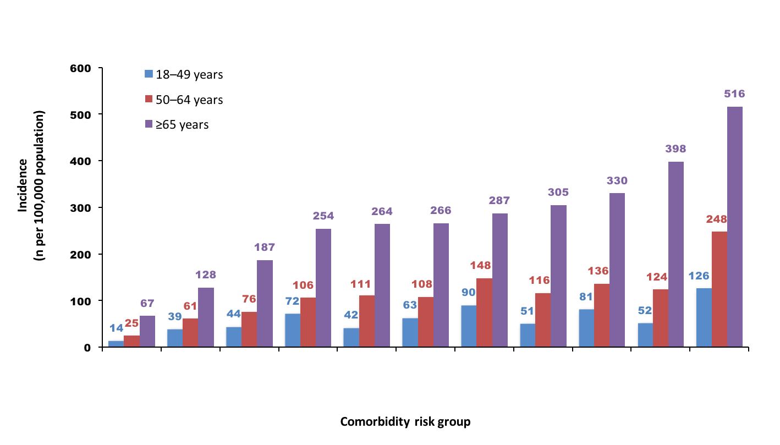
Co-morbidities increase pneumococcal pneumonia risk in adults
Data from a retrospective cohort study from 3 large, longitudinal, US health care
databases of medical and outpatient pharmacy claims from 2007–2010*
7.7x
Risk vs healthy
5.9x
4.6x
4.9x
4.0x
4.3x
3.8x
3.9x
2.8x
1.9x
None
Chronic
use of oral
steroids
Diabetes
Chronic
heart
disease
Smokers
Rheumatoid
arthritis/
Crohn’s/
lupus
Chronic
liver
disease
Alcoholism
Neuro-
muscular/
seizure
disorders
Asthma
Chronic
lung
disease
*Persons aged 18–49 years, 50–64 years, and ≥65 years contributed a total of 49.3 million, 30.6 million, and 11.7 million person-years of observation, respectively.
1. Shea KM, et al. Open Forum Infect Dis. Published online May 8, 2014. doi:10.1093/ofid/ofu024.
Notes:
Key Points
Chronic conditions put patients aged 18 years and older at increased risk for pneumococcal pneumonia.
Patients aged 65 years and older are already at increased risk for pneumococcal pneumonia, which increases even further with the presence of chronic conditions.
Notes
A retrospective cohort analysis was conducted utilizing health care claims data from 2007 through 2010 to compare rates of pneumococcal disease among persons with certain chronic conditions versus their age-matched healthy counterparts.¹
Data for this study were collected from 3 large integrated health care claims databases during the period of January 1, 2006, to December 31, 2010. The databases include medical (ie, facility and professional service) claims and outpatient pharmacy claims from private US health plans. Plan members total more than 35 million annually and are geographically diverse.¹
The rate of pneumococcal pneumonia in adults 18 to 49, 50 to 64, and ≥65 years of age was higher among persons with certain chronic conditions versus healthy counterparts. Chronic conditions associated with an increased risk of pneumococcal pneumonia included chronic use of oral steroids; diabetes; rheumatoid arthritis/Crohn’s/lupus; chronic heart, liver, or lung disease; neuromuscular/seizure disorders; alcoholism; asthma; and smoking.¹
Reference
Shea KM, Edelsberg J, Weycker D, Farkouh RA, Strutton DR, Pelton SI. Rates of pneumococcal disease in adults with chronic medical conditions [published online May 8, 2014]. Open Forum Infect Dis. doi:10.1093/ofid/ofu024.

Slide 24
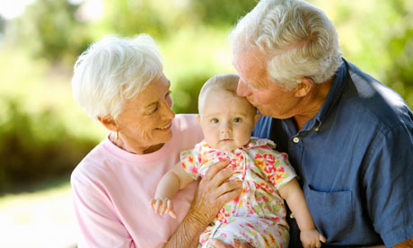
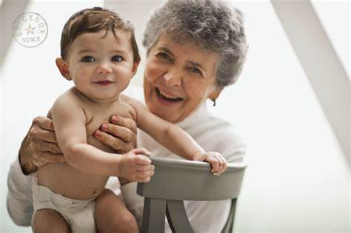
People AT RISK
Extremes of age
    Infants and older adults
Krone CL. Immunosenescence and pneumococcal disease: an imbalance in host-pathogen interactions. Lancet Respir Med. 2014;2(2):141. Epub 2013 Sep 18
Notes:
Pneumococcal pneumonia occurs most frequently in infants and toddlers and in older adults.
It is suggested that the global burden of pneumococcal disease will increase as life expectancy increases [18]. The effect of older age is multifactorial, including (but limited to) increased likelihood of unrecognized aspiration and/or decreased clearance of aspirated nasopharyngeal bacteria, decreased cytokine production and/or decreased responsiveness to interleukin 1 and tumor necrosis factor-alpha, and suboptimal nutritional status

Slide 25
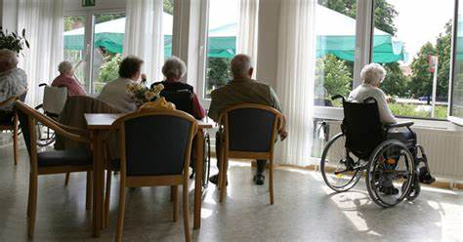
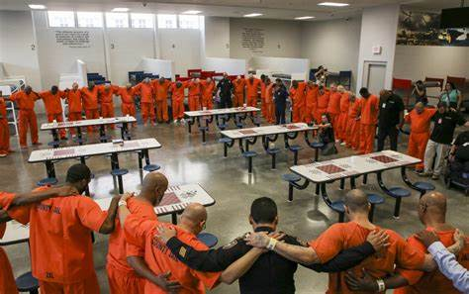
People AT RISK
Crowded living conditions
  Outbreaks in shelters, jails, and nursing homes and long-term care facilities
Gleich S. Streptococcus pneumoniae serotype 4 outbreak in a home for the aged: report and review of recent outbreaks. Infect Control Hosp Epidemiol. 2000;21(11):711.
Notes:
Outbreaks of pneumococcal pneumonia have also been described in shelters [23], jails [24], and nursing homes and long-term care facilities

Slide 26
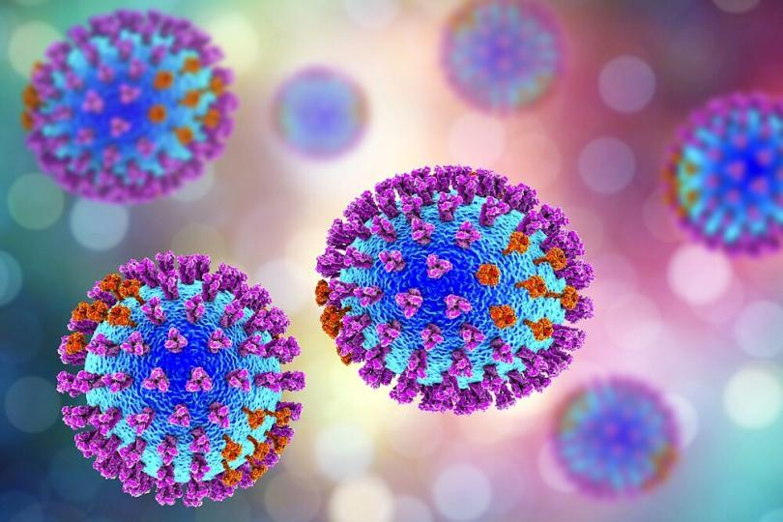
People AT RISK
Viral infection
  Influenza predisposes to secondary pneumococcal pneumonia
  Increase in prevalence of viral and pneumococcal coinfection
Garg S. Pneumonia among adults hospitalized with laboratory-confirmed seasonal influenza virus infection-United States, 2005-2008.BMC Infect Dis. 2015;15:369. Epub 2015 Aug 26.
Notes:
Influenza infection greatly predisposes to secondary pneumococcal pneumonia [30], and infection by other viruses probably does, as well, as evidenced by the prevalence of viral and pneumococcal coinfection

Slide 27

People AT RISK
Alcohol use disorder
  Decreased cough and epiglottis reflex
  Defects in mucociliary clearance
  Suppression of cytokine and chemokine responses
Uptodate 2022. Pneumococcal pneumonia in patients requiring hospitalization
Notes:
Multiple elements of host defenses are impaired in alcohol abuse including decreased cough and epiglottis reflex, defects in mucociliary clearance, suppression of cytokine and chemokine responses, and multiple effects on neutrophil function (adhesion, migration to site of infection, and killing of pneumococci). With chronic alcohol use disorder, malnutrition and liver disease play further contributory roles.

Slide 28
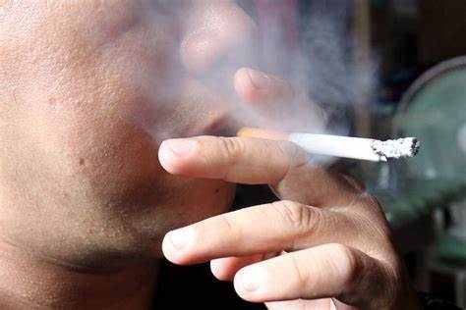
People AT RISK
Cigarette smoking
  Increased nasopharyngeal colonization
  Invasive pneumococcal disease is highly associated with cigarette smoking and with passive smoke exposure
  Due to damaged pulmonary clearance
Nuorti JP. Cigarette smoking and invasive pneumococcal disease. Active Bacterial Core Surveillance Team. N Engl J Med. 2000;342(10):681.
Notes:
Nasopharyngeal colonization is increased in cigarette smokers and even in children of parents who smoke [32]. Pneumococcal pneumonia (specifically, invasive pneumococcal disease, most of which is due to pneumonia) is highly associated with cigarette smoking (odds ratio [OR] 4.1, 95% CI 2.4-7.3) and with passive smoke exposure (OR 2.5, 95% CI 1.2-5.1) [33]. A dose-response relationship was demonstrable for number of cigarettes smoked per day, packs per year of smoking, and time since quitting. Presumably, damaged pulmonary clearance is largely responsible, but other lifestyle factors also play a role.

Slide 29

People AT RISK
COPD and other lung disorders
Uptodate 2022. Pneumococcal pneumonia in patients requiring hospitalization

Slide 30
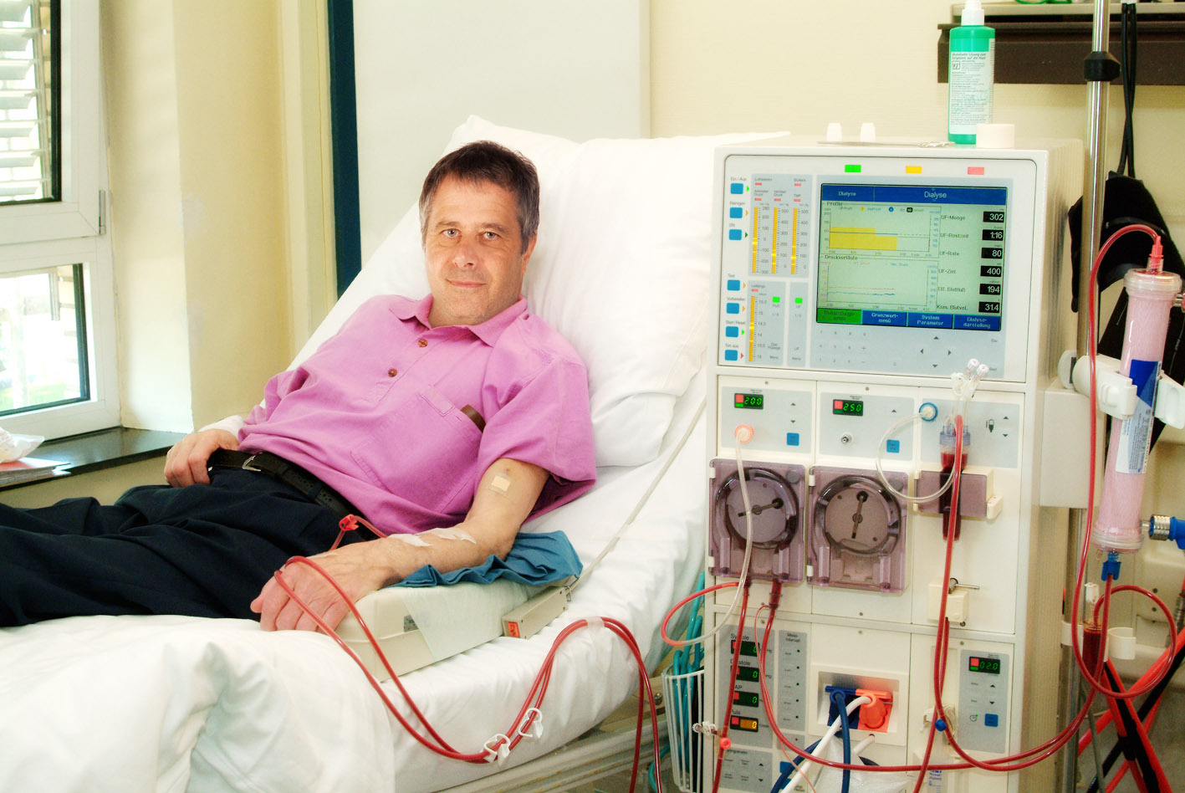
People AT RISK
CONDITIONS
Malignancy
HIV
Autoimmune diseases
Dialysis patient
Transplant patients
Diabetes
Immunocompromised host
Uptodate 2022. Pneumococcal pneumonia in patients requiring hospitalization
Notes:
The principal host defense against pneumococcal pneumonia is antibody to pneumococcal capsular polysaccharide, thus, any condition that reduces the antibody response to new antigens is highly likely to predispose to pneumococcal pneumonia.

Slide 31
People AT RISK
Extremes of age
Crowded living conditions
Viral infection
Alcohol use disorder
Cigarette smoking
COPD and other pulmonary disorders
Immunocompromised hosts
Uptodate 2022. Pneumococcal pneumonia in patients requiring hospitalization

Slide 32
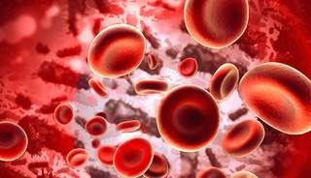
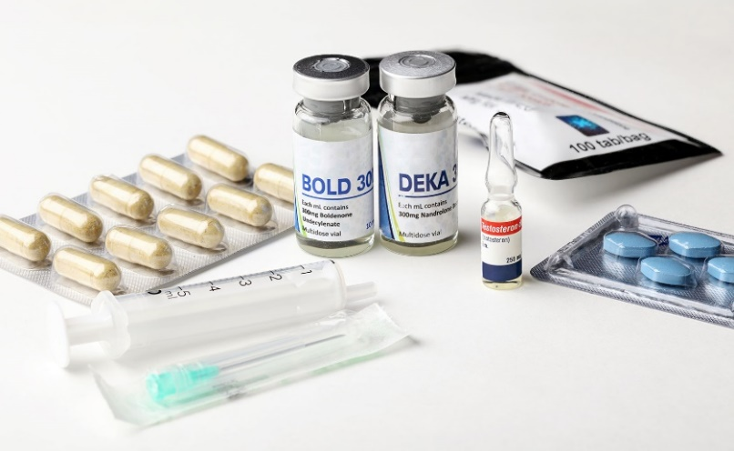
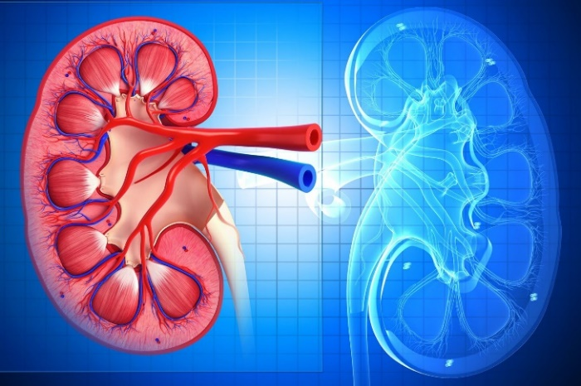
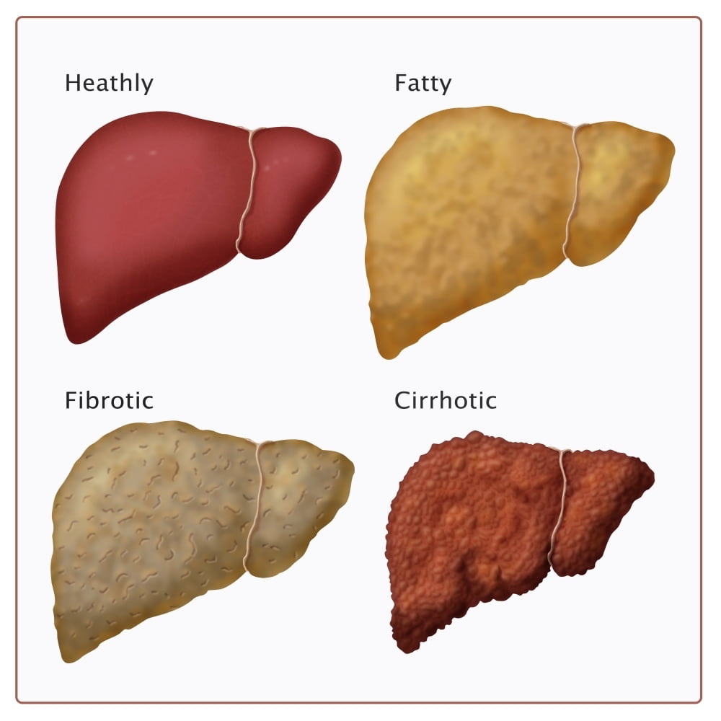

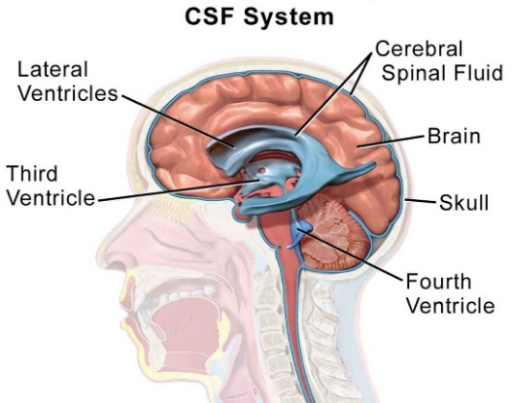
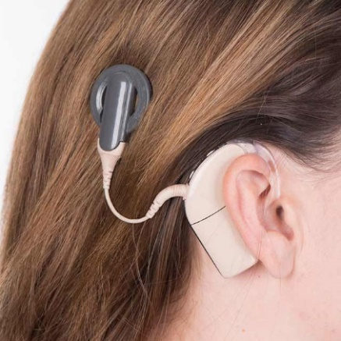
People AT RISK – Invasive Pneumococcal Disease
Hematologic cancer
Immunosuppressive conditions from disease or drugs
Functional or anatomic asplenia
Renal disease.
Chronic heart disease
Lung disease (including asthma)
Liver disease
Smoking cigarettes
Alcoholism
CSF leak
Cochlear implant
Pinkbook: Pneumococcal Disease | CDC
Notes:
Adults with certain medical conditions are at highest risk for invasive pneumococcal disease. For adults age 18 through 64 years with hematologic cancer, the rate of invasive pneumococcal disease in 2013–2014 was 129 per 100,000 population. Other conditions that place adults at highest risk for invasive pneumococcal disease include other immunosuppressive conditions from disease or drugs, functional or anatomic asplenia, and renal disease. Other conditions that increase the risk of invasive pneumococcal disease in adults include chronic heart disease, lung disease (including asthma), liver disease, smoking cigarettes, alcoholism, CSF leak, and having a cochlear implant.

Slide 33
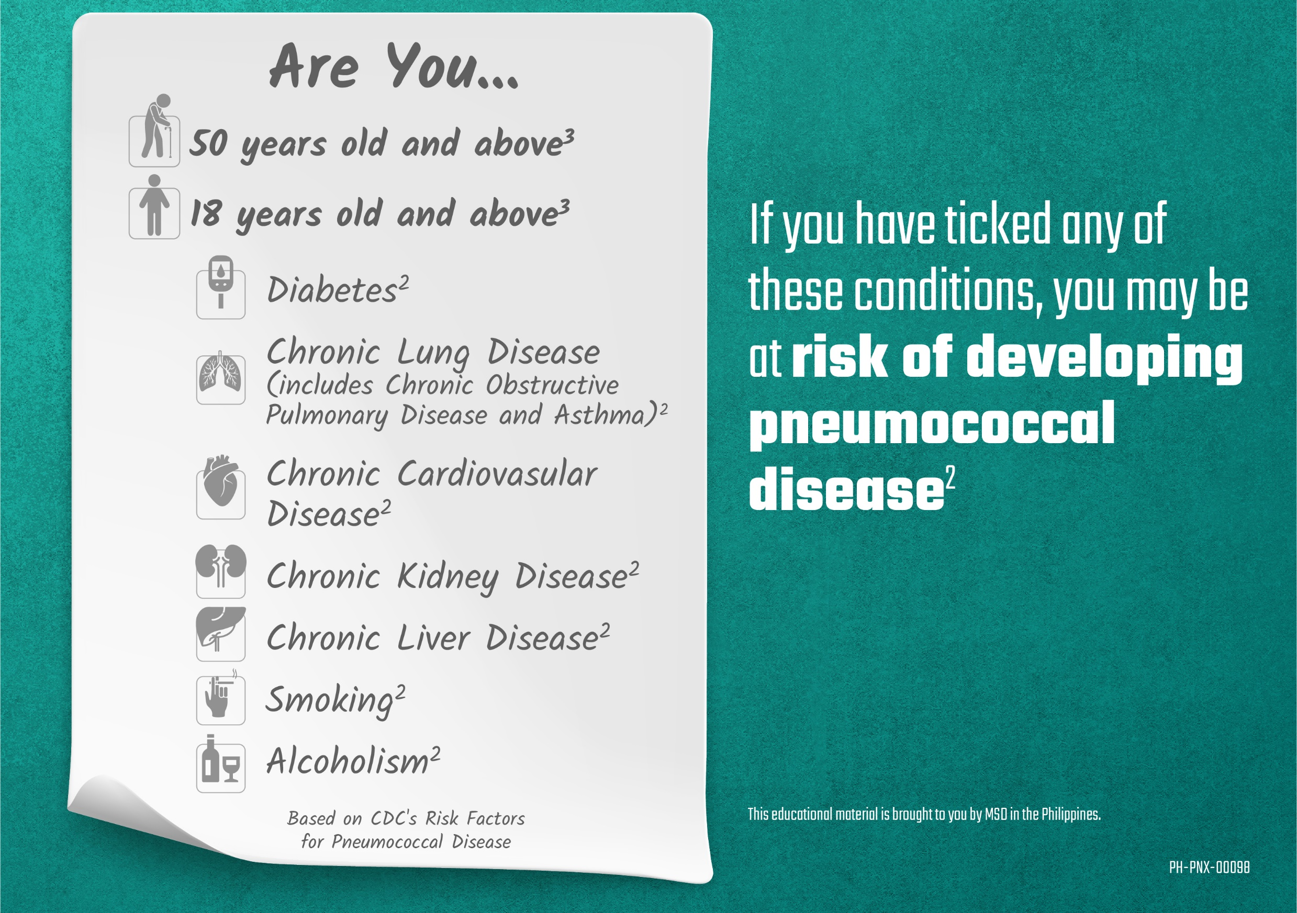

Slide 34
Pneumococcal Vaccine Types
PCV and PPSV

Slide 35
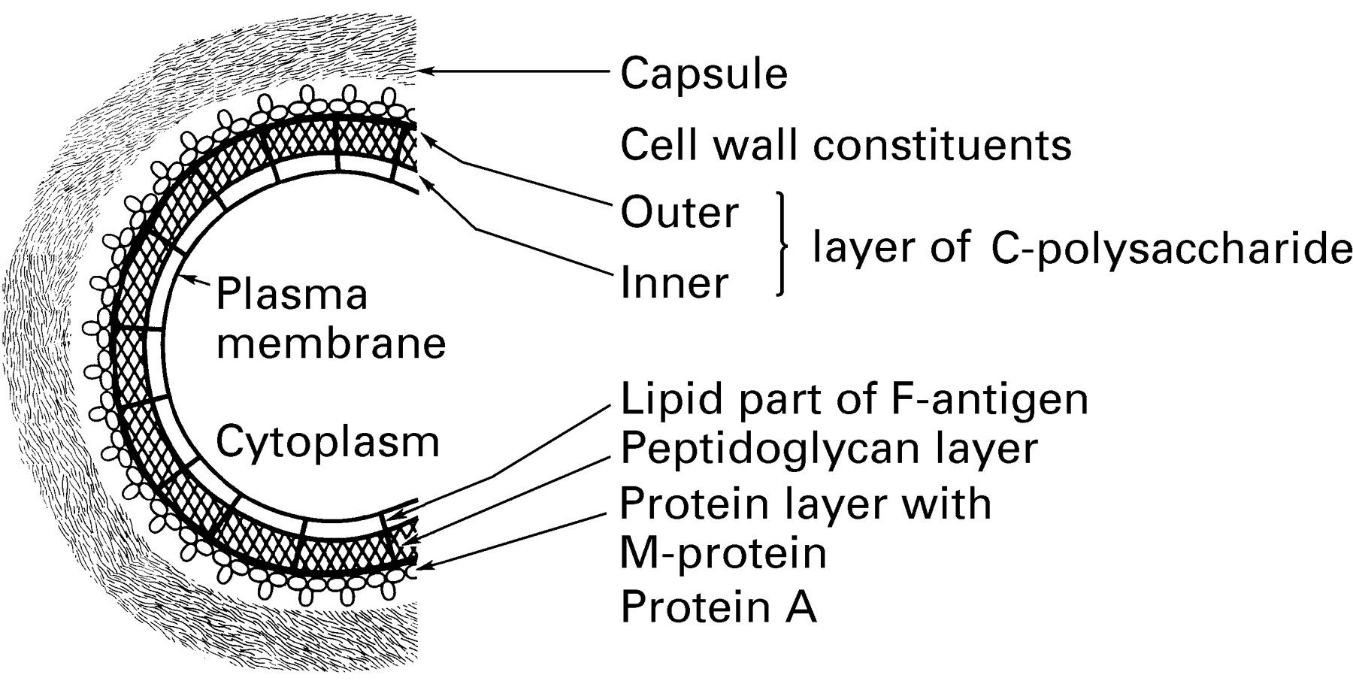
Surface capsular polysaccharide of S. pneumoniae
Pneumococcal Vaccine Types
Vaccine Types
Uptodate. 2022. Pneumococcal vaccine in adults
Notes:
The surface capsular polysaccharide of S. pneumoniae provokes a type-specific protective immune response and serves as the basis for serotyping of these organisms
Most pneumococci are encapsulated, and their surfaces are composed of complex polysaccharides.
Capsular polysaccharides are one determinant of the pathogenicity of the organism. They are also antigenic and form the basis for classifying pneumococci by serotypes.

Slide 36
Pneumococcal Vaccine Types
POLYSACCHARIDE vaccines — PPSV is composed of partially purified pneumococcal capsular polysaccharides.
        The only available formulation contains 23 pneumococcal polysaccharides from the 23 serotypes that were the most common cause of pneumococcal disease in adults in the 1980s.
CONJUGATE vaccines — PCV consist of pneumococcal capsular polysaccharides covalently linked (conjugated) to a protein
Uptodate. 2022. Pneumococcal vaccine in adults
Notes:
Polysaccharide vaccines — PPSV is composed of partially purified pneumococcal capsular polysaccharides. The only available formulation contains 23 pneumococcal polysaccharides (PPSV23; Pneumovax or Pnu-Immune) from the 23 serotypes that were the most common cause of pneumococcal disease in adults in the 1980s
Conjugate vaccines — PCV consist of pneumococcal capsular polysaccharides covalently linked (conjugated) to a protein.

Slide 37

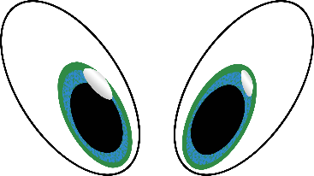


Depicting PCV
PROTEIN
MEMORY CELLS
MEMORIES
Polysaccharide unit

Slide 38
Depicting PPSV
MEMORY CELLS
MEMORIES
Polysaccharide unit
Notes:
The immune response to a pure polysaccharide vaccine is typically T-cell-independent, which means these vaccines can stimulate B-cells without the assistance of T-helper cells. T-cell-independent antigens, including polysaccharide vaccines, are not consistently immunogenic in children younger than age 2 years, probably because of immaturity of the immune system. Attaching the polysaccharide antigen to a protein makes it possible to prevent bacterial infections in populations where a polysaccharide vaccine is not effective or provides only temporary protection

Slide 39
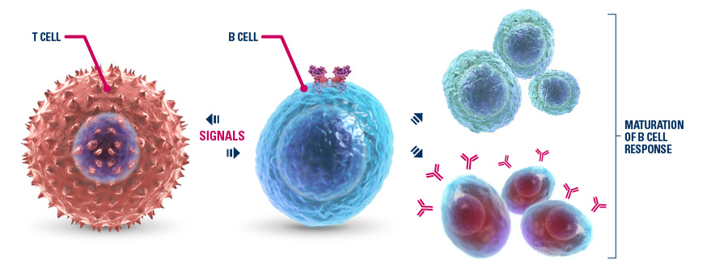
PNEUMOCOCCAL POLYSACCHARIDE VACCINE (PPSV) | PNEUMOCOCCAL CONJUGATE VACCINE (PCV)
T-cell independent immune response | T-cell dependent immune response
Stimulate B cells to produce antibodies | Stimulate T cells to help B cells produce antibodies and generate IMMUNE MEMORY
Low/absent immune response in children < 2 years of age | Induce an effective immune response in infants
Antibody response primarily IgM | Stimulate an initial response involving both IgM and IgG while subsequent doses stimulate primarily IgG response
Do NOT induce immunological memory | Induce immunological memory
ANTIBODIES
Eskola J. PIDJ 2000. 19 (4): 388-93.

Slide 40
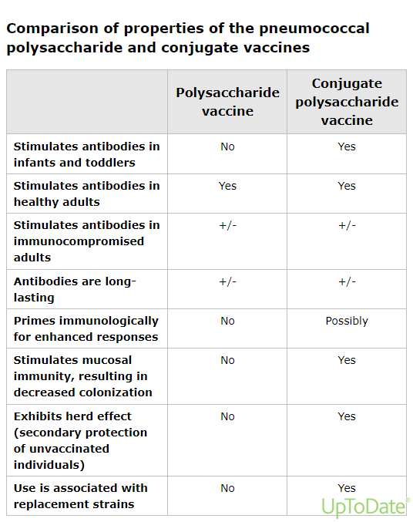
PCV vs PPSV
Uptodate. 2022. Pneumococcal vaccine in adults
Notes:
PCV stimulates mucosal immunity, thereby preventing nasal colonization of Streptococcus pneumoniae. Mucosal immunity leads to two population-level effects: (1) indirect (herd) immunity and (2) emergence of replacement strains. With widespread use of PCV in infants and children, pneumococcal transmission decreases and thus lends protection to unvaccinated individuals (including adults)

Slide 41
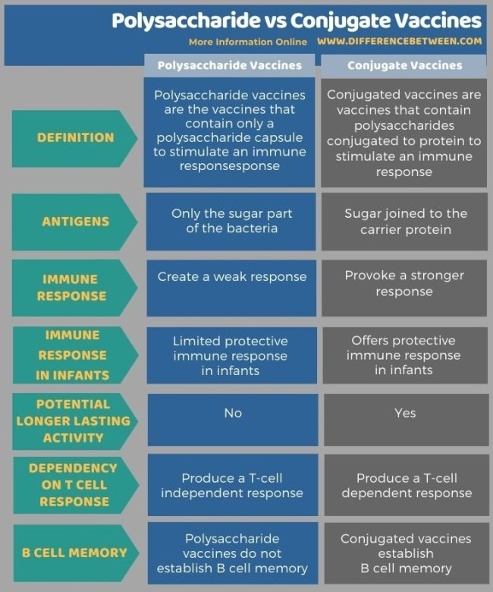
PCV vs PPSV
Difference Between Polysaccharide and Conjugate Vaccines |
Compare the Difference Between Similar Terms
“Principles of Vaccination.” CDC

Slide 42
Adult Immunization Guidelines

Slide 43
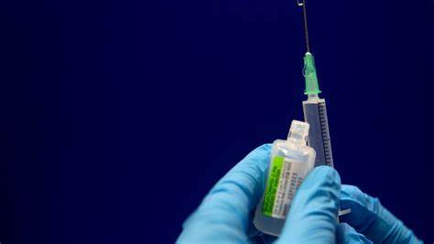
In General
Routine use of PCV13 or PPSV23 is not recommended for healthy adults age 19 through 64 years.
Unvaccinated persons age 19 years or older with certain immunocompromising conditions, cerebrospinal fluid leak, or cochlear implant
        Single dose of PCV13 followed by a dose of PPSV23 at least 8 weeks later.
        If a dose of PPSV23 was given first, PCV13 should be administered at least 1 year later.
        A second dose of PPSV23 is recommended 5 years after the first PPSV23 dose for adults with anatomic or functional asplenia, or other immunocompromising conditions.
Difference Between Polysaccharide and Conjugate Vaccines |
Compare the Difference Between Similar Terms
“Principles of Vaccination.” CDC
Notes:
Routine use of PCV13 or PPSV23 is not recommended for healthy adults age 19 through 64 years.
Unvaccinated persons age 19 years or older with certain immunocompromising conditions, cerebrospinal fluid leak, or cochlear implant (see table “Conditions with Pneumococcal Vaccination Indications”, above) should receive a single dose of PCV13 followed by a dose of PPSV23 at least 8 weeks later. If a dose of PPSV23 was given first, PCV13 should be administered at least 1 year later. A second dose of PPSV23 is recommended 5 years after the first PPSV23 dose for adults with anatomic or functional asplenia, or other immunocompromising conditions.

Slide 44

Conditions | PCV13 indicated for 2 through 71 Months* | PCV13 indicated for 6 through 18 Years* | PCV13 indicated for 19 Years or Older | PPSV23 indicated for 2 through 64 Years
Chronic heart or lung disease† | Yes | No | No | Yes
Diabetes | Yes | No | No | Yes
Chronic liver disease, including cirrhosis | Yes | No | No | Yes
Cigarette smoking (in adults) | Yes | No | No | Yes
Alcoholism (in adults) | Yes | No | No | Yes
Cerebrospinal Fluid (CSF) leak | Yes | Yes | Yes | Yes
Cochlear implant | Yes | Yes | Yes | Yes
Functional or anatomic asplenia, including sickle cell disease | Yes | Yes | Yes | Yes
Immunocompromising conditions§ | Yes | Yes | Yes | Yes
Persons living in special environments or social settings¶ | No | No | No | Consider
Pinkbook: Pneumococcal Disease | CDC

Slide 45
Conditions for Administration of PCV13 and PPSV23 in Adults
Medical Condition(s) | PCV 13 indicated for age 19 years or older | PPSV23 indicated for age 19 through 64 years | PPSV23 revaccination indicated for age 19 through 64 years | PCV13 indicated for age 65 years or older | PPSV23 indicated for age 65 years or older
None | No | No | No | Based on shared clinical decision-making | Yes If PCV13 has been given, then give PPSV23 at least 1 year after PCV13
Chronic heart disease, chronic lung disease, diabetes, alcoholism, chronic liver disease (including cirrhosis), current cigarette smoking, asthma | No | Yes | No | Based on shared clinical decision-making | Yes If PCV13 has been given, then give PPSV23 at least 1 year after PCV13 and at least 5 years after any PPSV23 given at less than age 65 years
Pinkbook: Pneumococcal Disease | CDC
Notes:
A single dose of PPSV23 is recommended for all adults age 65 years or older, regardless of previous pneumococcal vaccination history. If any PPSV23 dose(s) were given before age 65 years, a single, final dose of PPSV23 should be given at age 65 or at least 5 years after the last PPSV23 dose. If PPSV23 was administered at age 65 years or later, no additional doses are needed.

Slide 46
Conditions for Administration of PCV13 and PPSV23 in Adults
Medical Condition(s) | PCV 13 indicated for age 19 years or older | PSV23 indicated for age 19 through 64 years | PPSV23 revaccination indicated for age 19 through 64 years | PCV13 indicated for age 65 years or older | PPSV23 indicated for age 65 years or older
Cerebrospinal fluid leak, cochlear implant | Yes | Yes At least 8 weeks after PCV 13 | No | Yes If no previous PCV13 vaccination | Yes At least 8 weeks after PCV13 and at least 5 years after any PPSV23 given at less than age 65 years
Functional or anatomic asplenia (including sickle cell disease/other hemoglobinopathies) | Yes | Yes At least 8 weeks after PCV13 | Yes At least 5 years after first dose of PPSV23 | Yes If no previous PCV13 vaccination | Yes At least 8 weeks after PCV13 and at least 5 years after any PPSV23 given at less than age 65 years
Pinkbook: Pneumococcal Disease | CDC

Slide 47
Conditions for Administration of PCV13 and PPSV23 in Adults
Medical Condition(s) | PCV 13 indicated for age 19 years or older | PSV23 indicated for age 19 through 64 years | PPSV23 revaccination indicated for age 19 through 64 years | PCV13 indicated for age 65 years or older | PPSV23 indicated for age 65 years or older
Immunocompromising conditions* | Yes | Yes At least 8 weeks after PCV13 | Yes At least 5 years after first dose of PPSV23 | Yes If no previous PCV13 vaccination | Yes At least 8 weeks after PCV13 and at least 5 years after any PPSV23 given at less than age 65 years
Pinkbook: Pneumococcal Disease | CDC

Slide 48
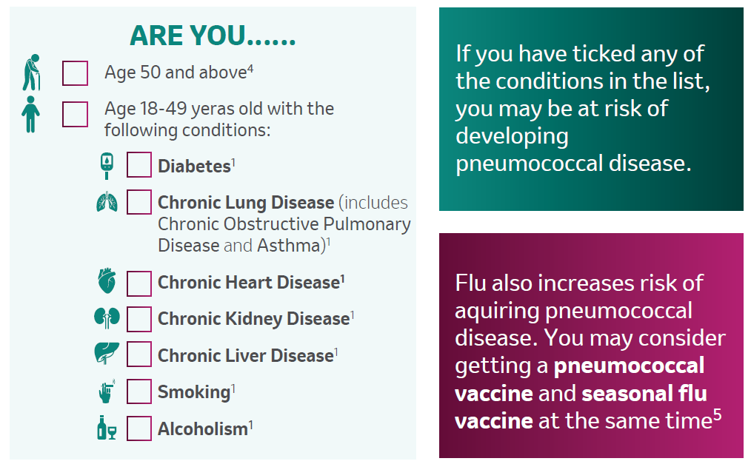
Philippine Society for Microbiology and Infectious Diseases. (2018) Clinical Practice Guidelines for Adult Immunization.
Centers for Disease Control and Prevention (CDC). Administering Pneumococcal Vaccines. https://www.cdc.gov/vaccines/vpd/pneumo/hcp/administering-vaccine.html.

Slide 49
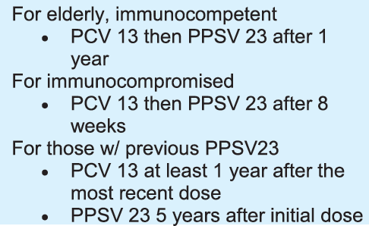
ADULT IMMUNIZATION GUIDELINES | Sequential Recommendation for Adults
Adults previously vaccinated with PCV13 still need a PPSV23 shot.
PCV13
1 YEAR or 8 WEEKS*
PPSV23
Patients given PPSV23 previously may be given PCV13 after 1 year.
PPSV23
1 YEAR
PCV13
For those with previous PPSV23, revaccination after 5 years
is also recommended.
PPSV23
5 YEARS
PPSV23
*8 weeks for immunocompromised patients (e.g., cancer, HIV, chronic renal failure)
Notes:
Both vaccines are needed.

Slide 50
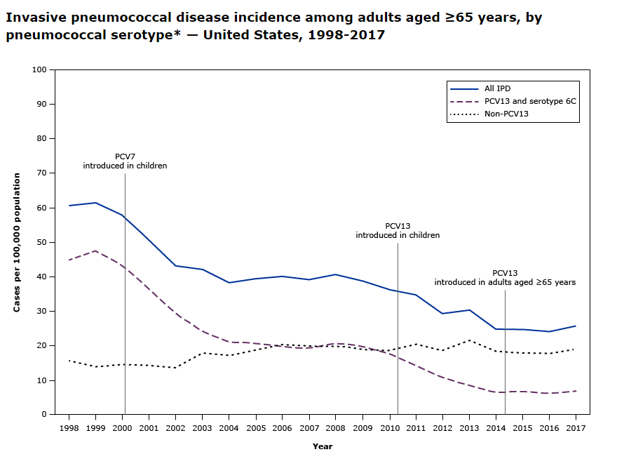
atanock A, Lee G, Gierke R, et al. Use of 13-valent pneumococcal conjugate vaccine and 23-valent pneumococcal polysaccharide vaccine among adults aged ≥65 years:
Updated recommendations of the Advisory Committee on Immunization Practices. MMWR Morb Mortal Wkly Rep 2019; 68:1069.

Slide 51
Timing and Consideration
PCV13 and PPSV23 should not be administered simultaneously.
The minimum interval between PCV13 and PPSV23 is 8 weeks for adults with immunocompromising conditions, and 1 year for immunocompetent adults.
If for procedure (splenectomy, chemotherapy, cochlear implant placement):
        If PCV13 and PPSV23 are both recommended, they both need to be administered, preferably before treatment or surgery.
        PPSV23 should be given at least 2 weeks before the treatment or surgery.
Pinkbook: Pneumococcal Disease | CDC

Slide 52
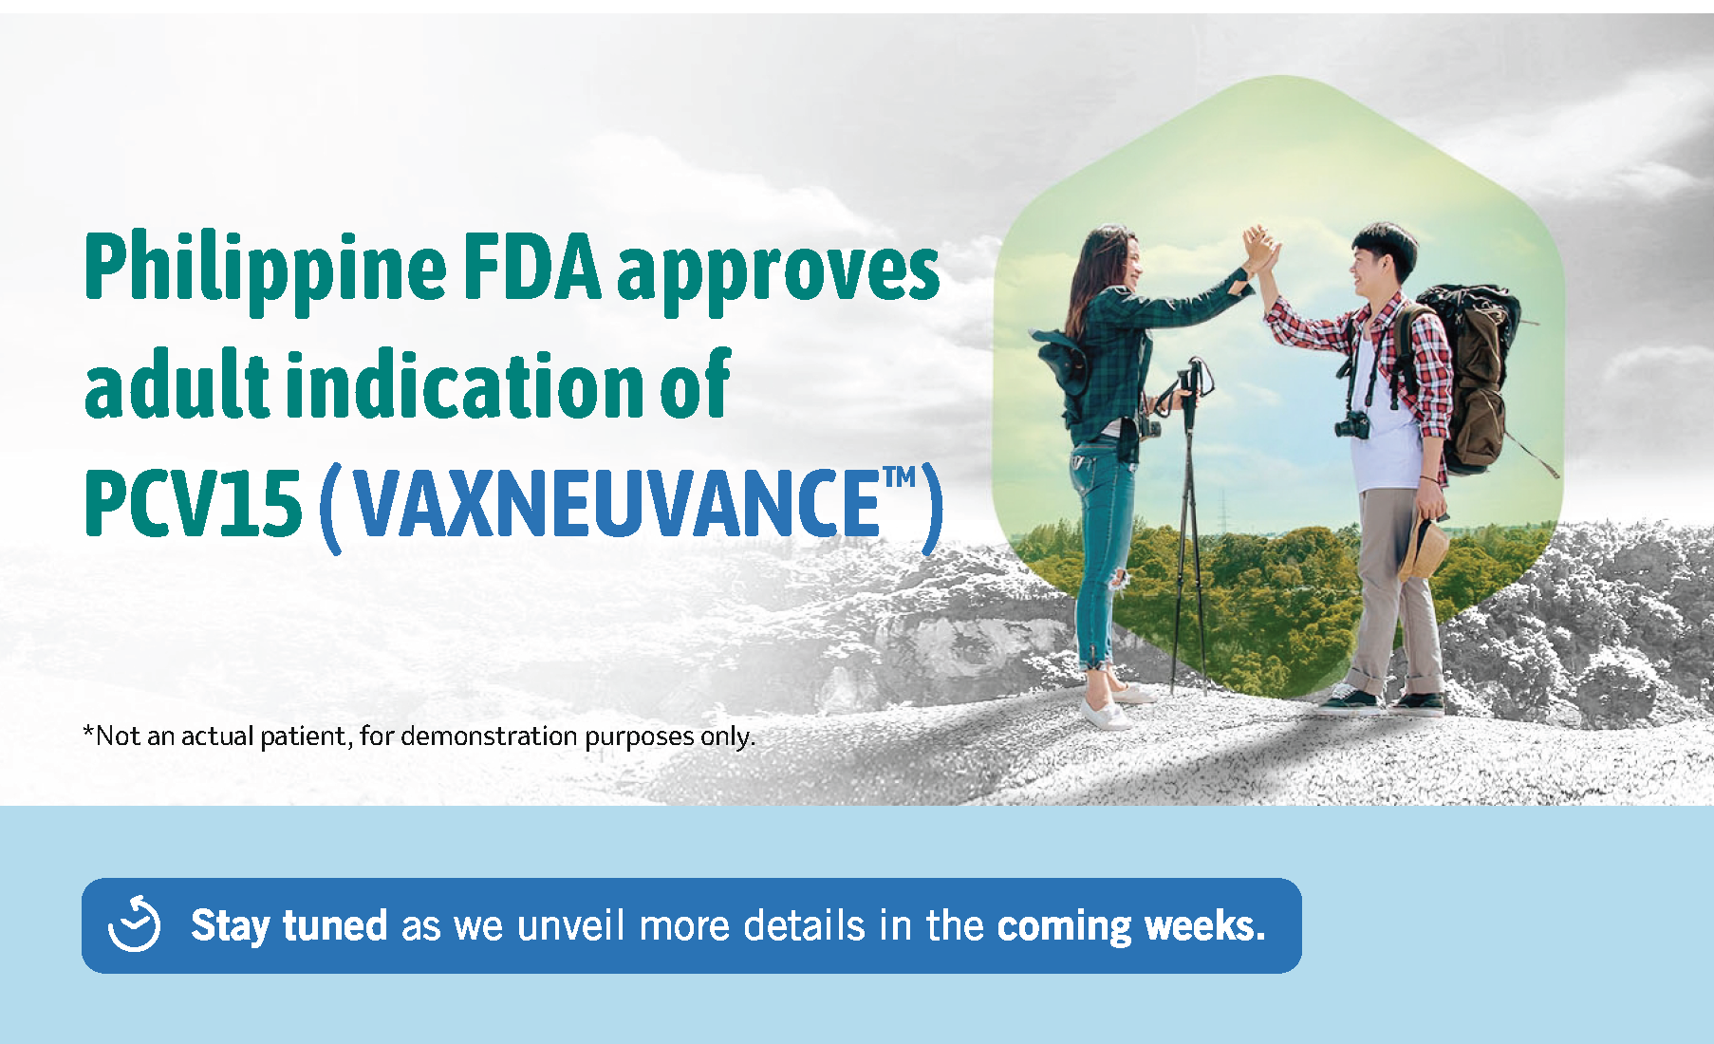



Slide 53

1. Centers for Disease Control and Prevention (CDC). Use of 15-valent pneumococcal conjugate vaccine and 20-valent pneumococcal conjugate vaccine among U.S. adults: Updated recommendations of the Advisory Committee on Immunization Practices- United States, 2022. MMWR. 2022;71:109-117.

Slide 54
COVID and Non-COVID Vaccine Interval

Slide 55

With COVID-19 Vaccine
COVID-19 vaccines may be administered without regard to timing of other vaccines.
Consider:
  Vaccine recipient’s risk of vaccine-preventable disease (i.e., during an outbreak, or an occupational exposure)
  Adverse event profile of the vaccines
  Vaccine recipient’s risk of delay in the recommended vaccines
Clinical Guidance for COVID-19 Vaccination | CDC

Slide 56

With COVID-19 Vaccine
IT’S A MUST!!
  Vaccine recipients should first be informed of the adverse effects before conducting a simultaneous vaccination.
Remind patients that:
  Increased likelihood of common adverse events
  Report any of these events
  Causality assessment may become difficult
Clinical Guidance for COVID-19 Vaccination | CDC

Slide 57
Managing Adverse Events

Slide 58

Adverse Events
Adverse Events
Before vaccination, providers should counsel recipients about common local and systemic post-vaccination reactions.
Reactions where the shot was given:
  Redness
  Swelling
  Pain or tenderness
Fever
Loss of appetite
Fussiness (irritability)
Feeling tired
Headache
Muscle aches or joint pain
Chills
Pinkbook: Pneumococcal Disease | CDC

Slide 59

These reactions usually resolved within 48 hours
Adverse Events
Medical Management of Vaccine Reactions in Adults in a Community Setting (immunize.org)

Slide 60

Contraindications
Contraindications
Anaphylaxis to any vaccine or a previous dose
Philippine Clinical Practice Guidelines for Adult Immunization, 2018

Slide 61
Precautionary Measures
Advise antihistamine use as a means of preventing milder allergic reactions in patients who might be at higher risk for allergic reactions.
Pinkbook: Pneumococcal Disease | CDC

Slide 62

Early Recognition of Anaphylaxis
Respiratory: sensation of throat closing or tightness, stridor (high-pitched sound while breathing), hoarseness, respiratory distress (such as shortness of breath or wheezing), coughing, trouble swallowing/drooling, nasal congestion, rhinorrhea, sneezing
Gastrointestinal: nausea, vomiting, diarrhea, abdominal pain, or cramps
Cardiovascular: dizziness; fainting; tachycardia (abnormally fast heart rate); hypotension (abnormally low blood pressure); pulse difficult to find or “weak”; cyanosis (bluish discoloration); pallor; flushing
Skin/mucosal: generalized hives; widespread redness; itching; conjunctivitis; or swelling of eyes, lips, tongue, mouth, face, or extremities
Neurologic: agitation; convulsions; acute change in mental status; sense of impending doom (a feeling that something bad is about to happen)
Other: sudden increase in secretions (from eyes, nose, or mouth); urinary incontinence
Management of Anaphylaxis at Vaccination Sites | CDC

Slide 63

If anaphylaxis happens..
Rapidly assess airway, breathing, circulation, and mentation (mental activity).
Call for emergency medical services (EMS).
Place the patient in a supine position (face up), with feet elevated
Epinephrine (1 mg/ml aqueous solution [1:1000 dilution]) is the first-line treatment for anaphylaxis and should be administered immediately.
Antihistamines (e.g., H1 or H2 antihistamines) and bronchodilators for hives and respiratory symptoms.
Monitor at the facility for 4 hours.
Management of Anaphylaxis at Vaccination Sites | CDC

Slide 64






To help prevent pneumonia:
Get vaccinated
Make sure children get vaccinated
Practice good hygiene
Don't smoke
Keep your immune system strong
64

Slide 65


Slide 66


Slide 67
Thank you!
PH-NON-00774 Aug 2022

